Slide 1
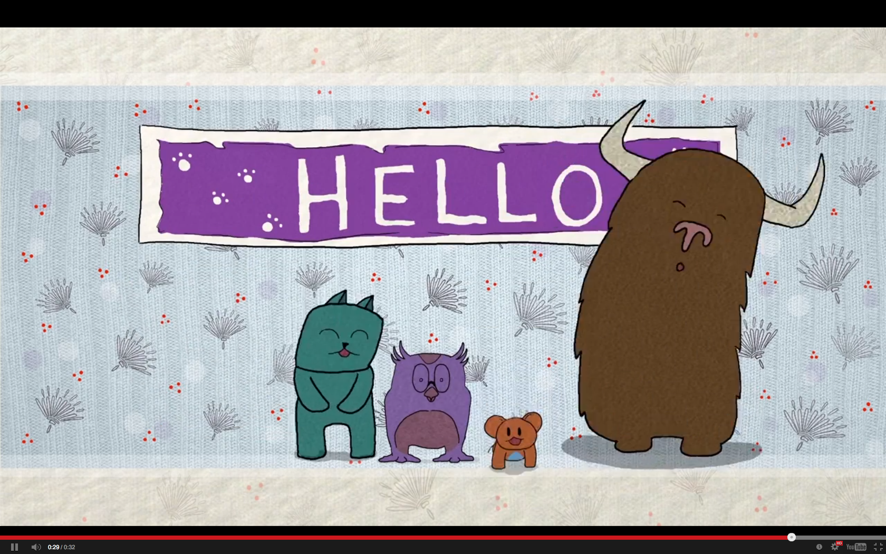

Slide 3
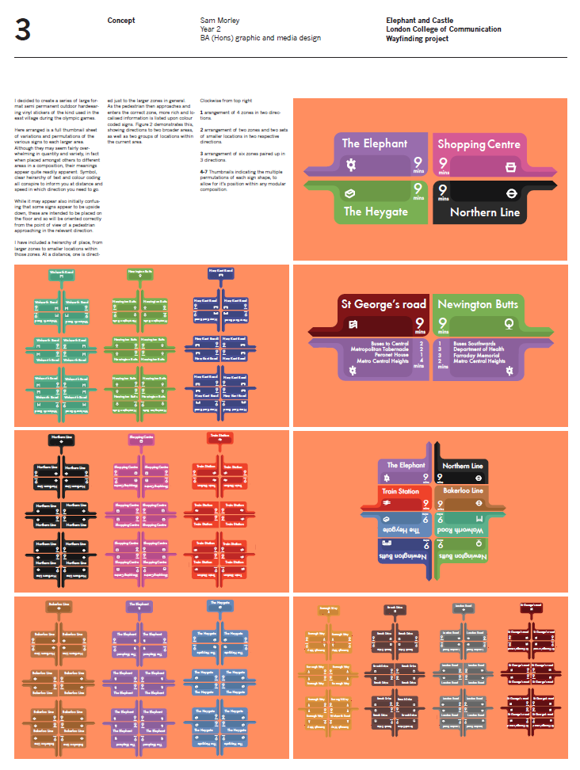
What is a sponsored student project?
A live brief for students, created in collaboration with a business or other external organisation. A business need is addressed by the project and UAL is paid a fee.

Slide 4
What is a sponsored student project?
A live brief for students, created in collaboration with a business or other external organisation. A business need is addressed by the project and UAL is paid a fee.

Slide 5
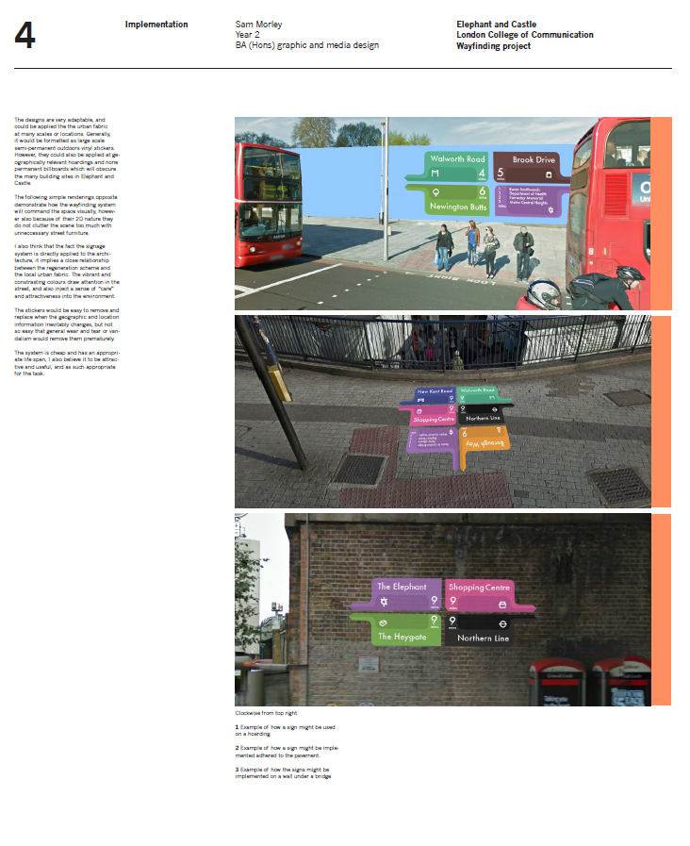
How does a Sponsored Student Project work at LCC?
Project brief
Creative brief
Students briefed
Present concepts
Present final designs

Slide 6
How does a Sponsored Student Project work at LCC?
Project brief
Creative brief
Students briefed
Present concepts
Present final designs

Slide 7
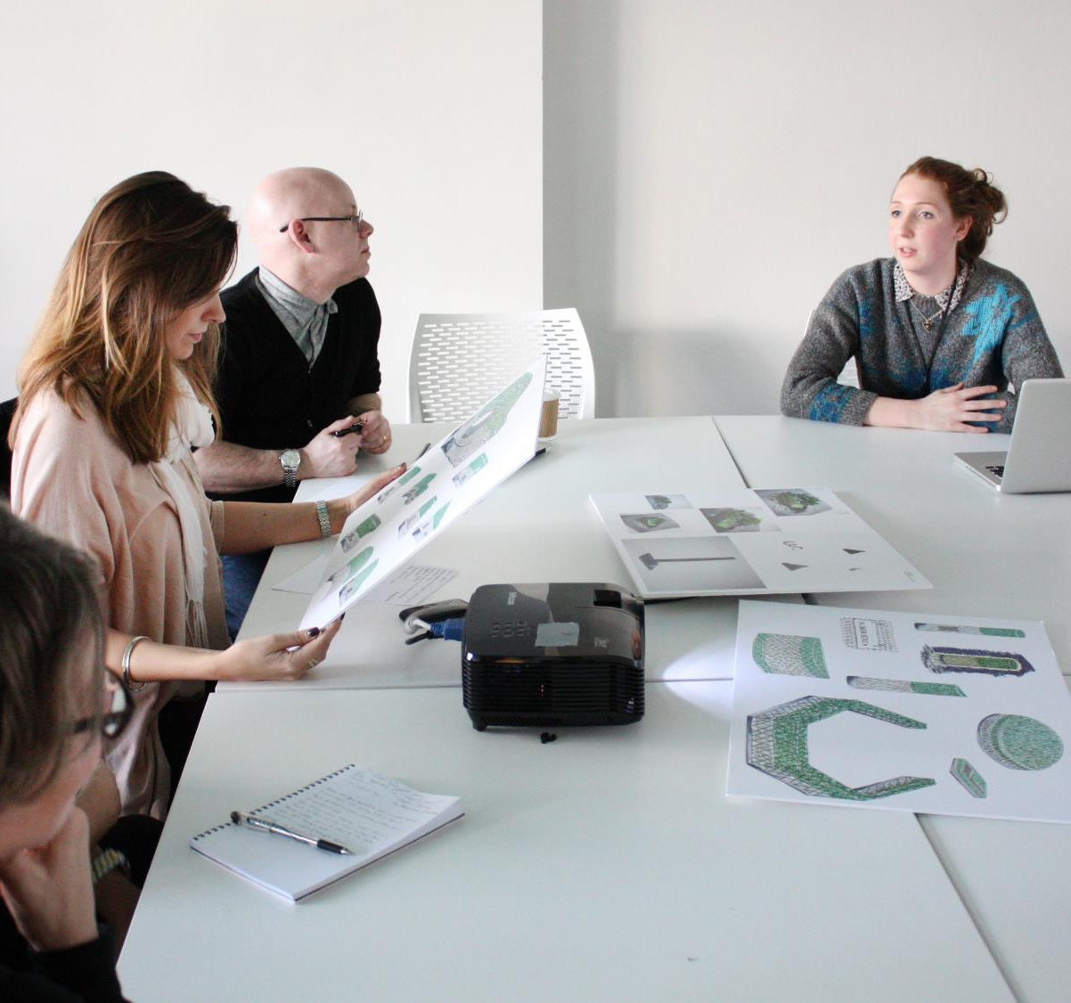
How are they funded?
Company pays fee for the project.
Fee includes additional teaching time, resources, licensing of LCC and UAL brand, PR support and IP purchase of work from students.
Profit is returning to the course.

Slide 8
How are they funded?
Company pays fee for the project.
Fee includes additional teaching time, resources, licensing of LCC and UAL brand, PR support and IP purchase of work from students.
Profit is returning to the course.

Slide 9
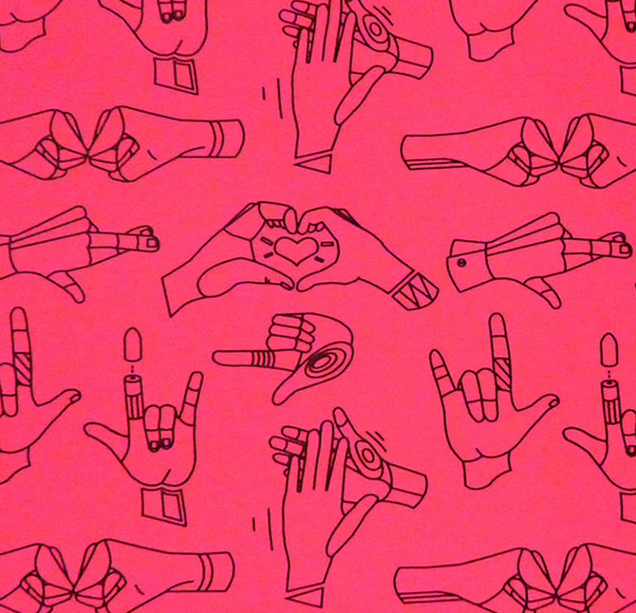
Two LCC sponsored student projects in 2014
Paperchase
Elephant and Castle Forum

Slide 10
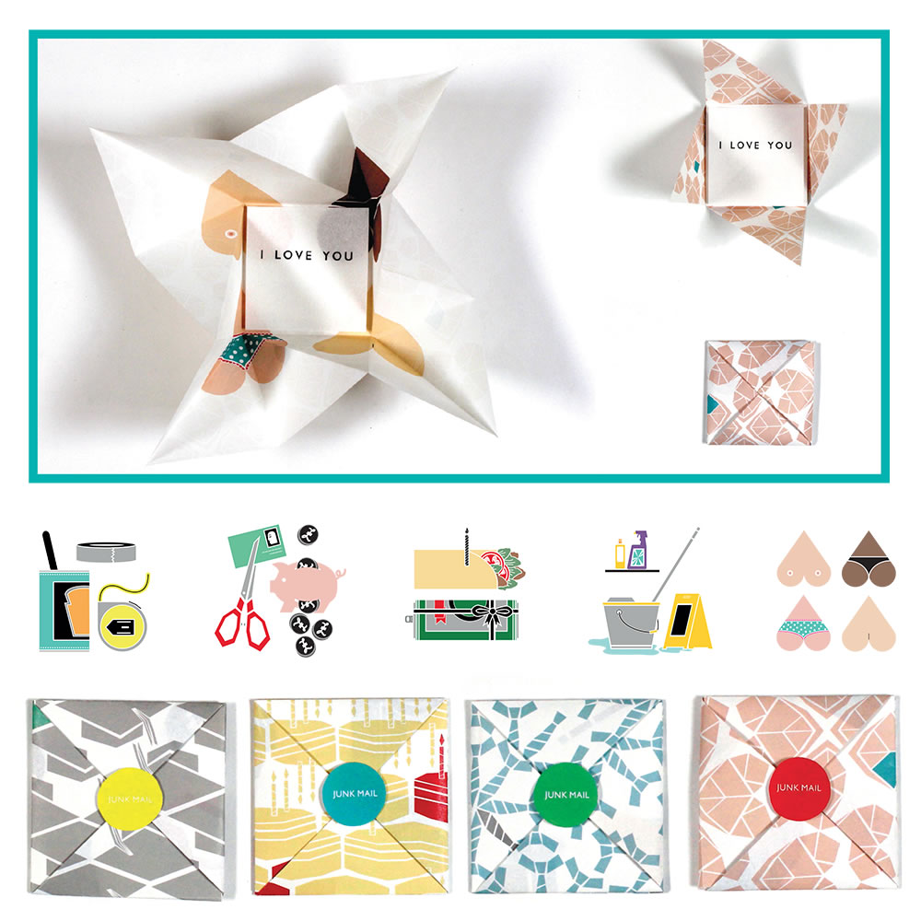
Paperchase
Company wanted new ideas for products based around the theme of “greetings”. Wrote an open brief leading to a high number of designs.
Students from BA (Hons) Graphic and Media Design, BA (Hons) Illustration and Visual Media, BA (Hons) Animation and BA (Hons) Surface Design.

Slide 11
Paperchase
Company wanted new ideas for products based around the theme of “greetings”. Wrote an open brief leading to a high number of designs.
Students from BA (Hons) Graphic and Media Design, BA (Hons) Illustration and Visual Media, BA (Hons) Animation and BA (Hons) Surface Design.

Slide 12
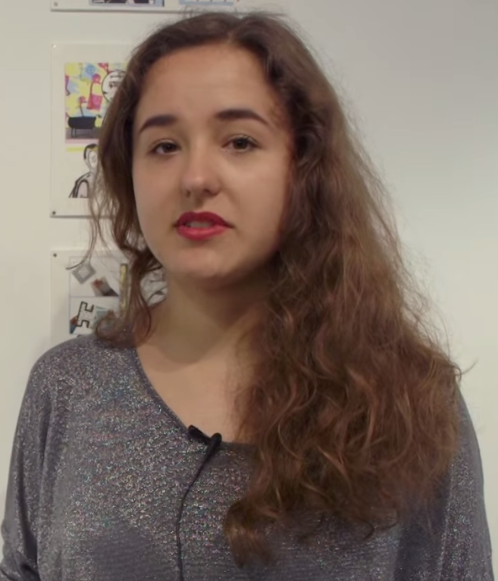
“It felt like working in industry which is a really good experience to have before I go out in to the real world after university.”
BA (Hons) Animation student

Slide 13
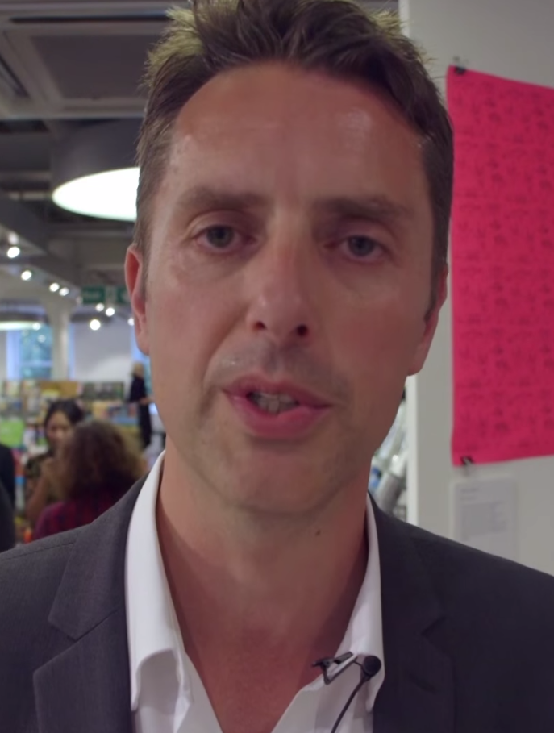
“As a brand creativity is at the absolute heart, and we’re delighted to support grassroots student talent.”
Paperchase Director

Slide 14
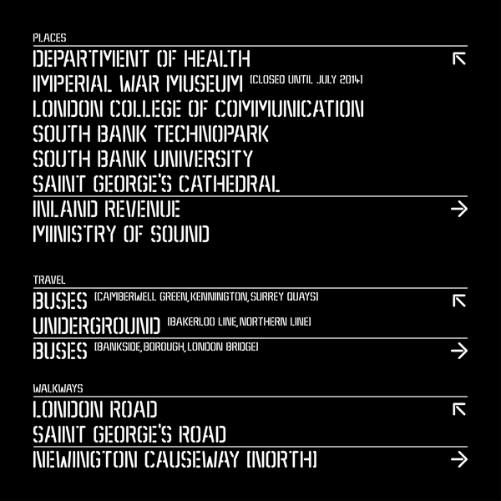
Elephant and Castle Forum
Forum of local businesses, property developers, Southwark Council and community groups.
Wanted ideas for a new Wayfinding system for pedestrians using Elephant and Castle during major redevelopment. Wrote a tight brief with clear requirements because they knew what the desired outcome should be.
Students from BA (Hons) Graphic and Media Design.

Slide 15
Elephant and Castle Forum
Forum of local businesses, property developers, Southwark Council and community groups.
Wanted ideas for a new Wayfinding system for pedestrians using Elephant and Castle during major redevelopment. Wrote a tight brief with clear requirements because they knew what the desired outcome should be.
Students from BA (Hons) Graphic and Media Design.

Slide 16
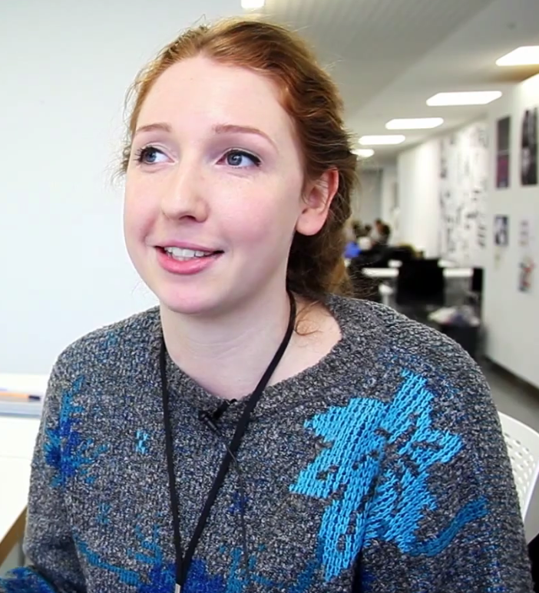
“I learnt how to put together a concept for a product that I wouldn’t be making myself, instead I had to persuade a client that they should produce my design.”
BA (Hons) Graphic and Media Design student

Slide 17
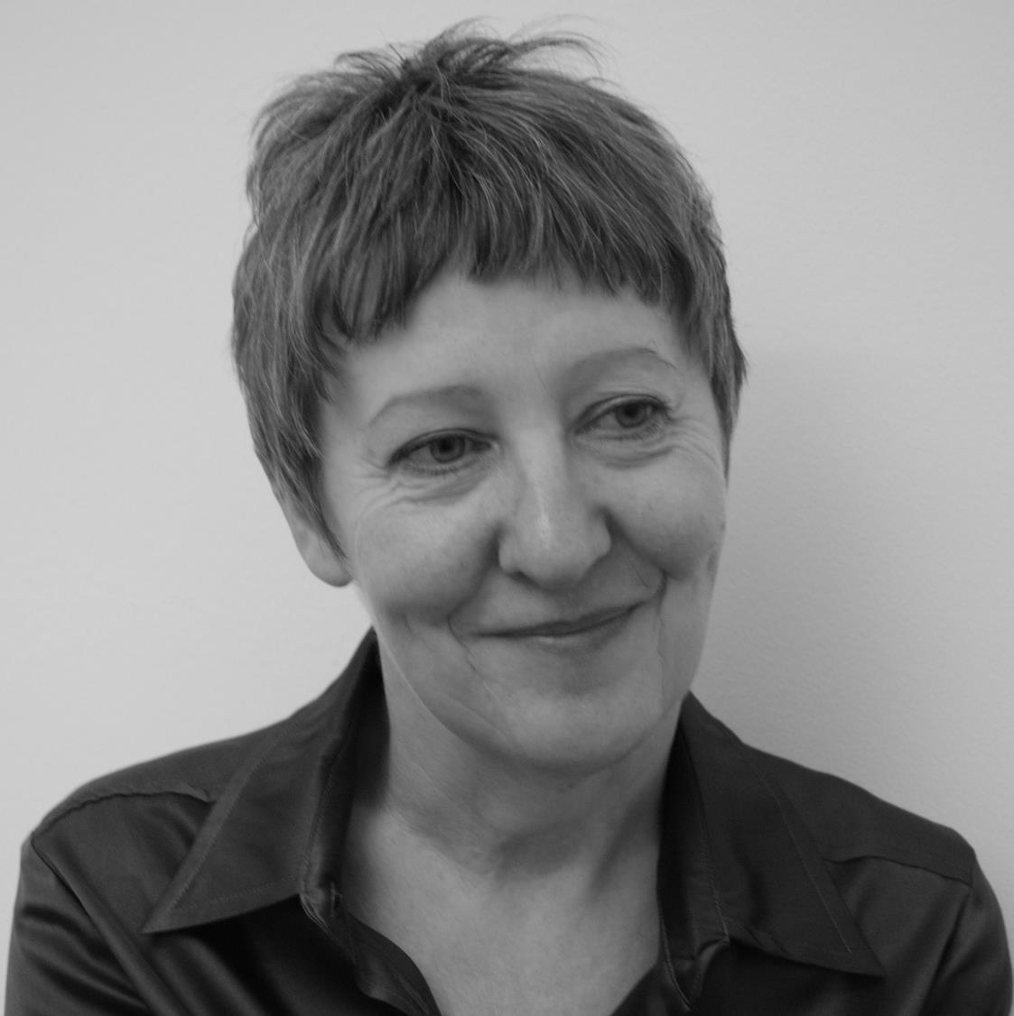
“Working with London College of Communication has brought into focus the creative spirit of the Elephant and Castle.
The opportunity to combine student ingenuity with the needs of local businesses and residents has been both rewarding and inspiring.”
Director, Central

Slide 18
Find out more
Matt Guy
020 7514 6554
matt.guy@lcc.arts.ac.uk

Slide 19
Find out more
Matt Guy
020 7514 6554
matt.guy@lcc.arts.ac.uk

Slide 20
Find out more
Matt Guy
020 7514 6554
matt.guy@lcc.arts.ac.uk

