Slide 1
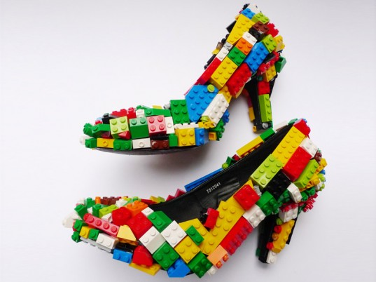
Engaging Imagination
Innovation & Risk in Creative Pedagogies
UAL LaTD 2015
Dr Alison James, Associate Dean Learning & Teaching LCF
National Teaching Fellow 2014
Finn Stone: Lego Fashion Stilettos
Notes:
Session outline:
Very pleased to be invited to give this in capacity as NTF and want to give special mention to Terry Finnigan who was our first NTF in 2010 and broke the barrier for us as an institution in terms of getting this recognition and we hope for many more.
Abstract:
When thinking about the arts, design and media it is easy to make generalisations about what they are and how we teach them. One is that creativity, innovation and risk are natural constituents, both of the disciplines and the ways we enquire into them. Another, resulting from this disciplinary 'gene pool', might be that the nature, context or purpose of the subject means that the ways we teach it will be creative and innovative too. A third might be that as we encourage creativity, innovation and risk in our students' learning behaviours we are equally open to demonstrating them in our teaching. While we can all come up with examples of how and where these generalisations are borne out, this talk will consider explore where variance might exist between creativity, innovation and risk as embodied in exploration of the subject per se, and as factors which shape our teaching practices, pedagogies and philosophies. A notable illustration of this variance can be seen how we assess student reflection and metacognition, through avenues such as PPD. In the HE sector, including the arts and design, traditional, text-based modes of engagement and assessment dominate the ways students record critical evaluations of their learning and development. In this talk Alison will explore how, where and why creative pedagogies and alternative approaches to reflection may enhance student engagement with their own learning and align more integratively with the disciplines.

Slide 2
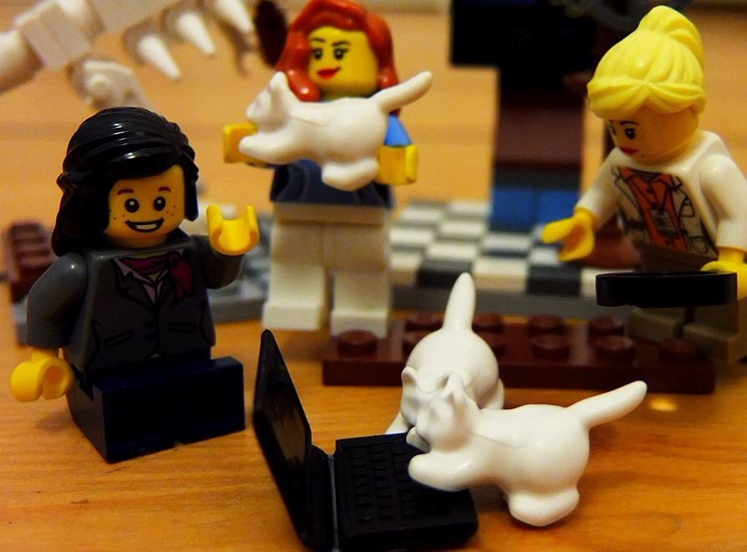
@Lego Academics pic.twitter.com/WAFduBPAOd

Slide 3
Creativity, imagination and play in
Practice
Pedagogy
Reflection
How do they differ and interlink?
How is creativity taught, nurtured, expressed in 2 and 3?
Is it always taught in 1?
Notes:
How are we/I defining pedagogy as opposed to tips and tricks?
Using term pedagogic research because despite the use of andragogy as a term defining adult learning we don’t talk about andragogic research within the institution, and despite some definitions which see pedagogy as to do with children there are others which are broader in scope.
We get students to do amazing creative things or put them in innovative situations or give them exciting briefs to respond, but is our actual teaching underpinned by responsive, effective pedagogy underpinned by the principles and philosophies of how people learn. The short answer in many cases is yes, and you only have to look at the projects coming out of our own PG Cert teaching and learning at CLTAD to see the innovative, inspired and thoughtful explorations of own teaching that are going on. So my questions are as much to me as they are to all of us and are about taking the time to scrutinize practice as opposed to covering content or assuming that an interesting opportunity is de facto pedagogically sound and reasoned.
Colleagues have often said in the past that reflection is naturally a part of what artists, designers, makers, communicators do – you can’t extrictate it from practice. And this is true. And it is often about identity as well as practice – two more aspects of the invididual that you can’t always separate out. However we also know from looking at how we teach and assess across our Colleges that while the subject may be cutting edge we still rely on traditional modes of assessment such as essays and writing and even examinations: this is particularly evident in the recording and assessment of PPD. This is not going to be a lecture all about PPD however what PPD stands for is the self evaluation and critical analsysis of learning performance and progress by our students and we go through exactly the same kinds of thinking processes when we are judging our creaetive or our teaching practice, or for that matter any other life encounter that has gone well or badly – or simply gone.
So in the remainder of these slides I’m not going to give you the solutions, nor exhort you to do better when you may well be doing these things very well already, but take the time to consider some sample questions and example practices about how we explore and develop our teaching.
Practice – mastery of the subject or craft – how to be creative in our practice: creativity in pedagogy – how to adopt unusual, alternative, borrowed, playful or imaginative means to think about how we enhance creativity in the subject, topic, practice or issue or how we understand and review our learning capacities and strategies – is it about our identities as pedagogues rather than practitioners?
We talke about creative reflection – my lettering is a bit subtle but it goes in graduations of paleness – our focus on creative reflection
Pedagogy – ‘art or science of teaching’. OR?? Instructional methods. But its also about the moods, encounters and environments created by and for those methods.
Metacognition encompassed by reflection – but the very concept of reflection is much denser than the way I will use the term as shorthand in this lecture – we tackle this in the book.
Challenging the hegemony of written reflection
The thinking in front AND behind – was going to separate these out into two camps
Make point that this is not a lecture to teach creativity skills to students, or to focus on practice, although the second, third and fourth theme are all embedded in or focussed on practice
Practice – Lorna Watt’s knits, or the transformation of the Dubai Metro into a moving art museum for the everyday, are examples of practice but they may inform or inflitrate each of the other three
Metacognition is defined as "cognition about cognition", or "knowing about knowing". It comes from the root word "meta", meaning behind.^{[1]} It can take many forms; it includes knowledge about when and how to use particular strategies for learning or for problem solving.^{[1]} There are generally two components of metacognition: knowledge about cognition, and regulation of cognition.^{[2]}
Metamemory, defined as knowing about memory and mnemonic strategies, is an especially important form of metacognition.^{[3]} Differences in metacognitive processing across cultures have not been widely studied, but could provide better outcomes in cross-cultural learning between teachers and students
Reflection In the book we focus on how many of the ways of recording or evidencing reflection in the creative arts are text based, and argue for multisensory and multimodal ways of reflecting and capturing that reflection. We look at conceptions of visual learning and literacy and of intelligence too, which I won’t plunder here

Slide 4
Motivations
Values
Methodology
Philosophy
Needs
Notes:
Just some of the things that take pedagogy beyond tips and tricks of getting someone to learn how to do something – for entry into a disciplinary field as much as tying your shoe laces – why do you need to, what does it mean to you, how will it be valued, the philosophy of a rite of passage into independence and autonomy as a child, wanting to be like your peers

Slide 5
Motivations - wanting to inspire or trigger different ways of seeing
Values – why the activity matters
Methodology and Philosophy - constructionist
Needs – what are we trying to achieve?
Notes:
In the following examples

Slide 6
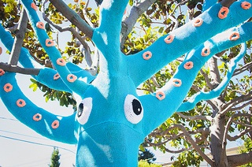
“For teachers, our notion of imaginative teaching necessarily entails them trying to see their pedagogic actions and reasoning in new and creative ways”
(James and Brookfield, 2014:11)
(Image Squid Tree Yarn Bomb CC by 2.0 LornaWatts)
Notes:
I’m going to be bandying terms like creativity, imagination and play around as factors in innovative teaching but they are not the only ones. So I will be defining terms

Slide 7
Creative practice
Creative practice pedagogy
Creative pedagogy
Creative pedagogic research
Innovation & risk in pedagogy: where do these occur in our teaching?
What innovative risks do we take in developing our teaching?
Notes:
We encourage our students to take risks, or not, and quite often we have discussions about where we allow studens to risk and fail without penalty, or conversely they perceive that risk is too risky – that there isn’t that room for manoeuvre.

Slide 8
“The time to experiment, imagine, and innovate in teaching is squeezed between other demands established by alternative research and quality focused taxonomies”
(Gunn V and Fisk A, 2013:52 Considering teaching excellence in higher education. Higher Education Academy Report (UK )
Notes:
We may also not see the point, and we may not see the point because we have not developed or thought through why innovation is needed, beyond the pragmatics of trying to keep attention, motivate and engage, stay current, push horizons

Slide 9
Possible features of innovative teaching (but not pedagogies per se)
Notes:
What does imagination look like in science or other subjects
A great deal of crossover between these three but they are not the same. All share process and feeling
“The imaginative activities of our brains can be conceived as a combination of both the neural and physiological responses our bodies produce in relation to imagined events as well as the significance of the imagination as a tool for learning. Claxton, Chambers, Power and Lucas (2011) note, as do practitioners of NeuroLinguisticProgramming (NLP; Vickers and Bavister, 2010) the power of visualizing imaginatively in order to better understand, perform in, or deal with situations (cf presentations)
Pat Kane and the Play Ethic – his ‘messiness and imprecision of play’ parallel with the other two and with reflection
The irony of colour – describing these terms in beige…
Freedom, not control and surveillance, however Claxton and others note the importance of a degree of self discipline rather than unbridled outpourings or actions. Sometimes it is a blend of the two such as in the writing of poetry – Auden or Housman was known to write poetry when walking and have conjured whole stanzas by the time he returned, but then might take months to hone and finish the last remaining parts of a poem. Lionel Bart described the process of song writing as one where the best songs come out like sneezes – instant and spontaneous, rather than laboured
All of these things contribute to make learning meaningful, mightinvolve or be cause by students being yanked out of their daily routine by some unexepcted challenge of unatincipated task. Sarah le Marquand’s experience of teaching in China and all the paper, pens and other amterials that were due to be used in class not arriving. So she and her students went out and made an installation out of loads of bicycles
What ifs and scenario building as illustrated by LSP
The shock of the new – the shock of the new to me
How we model these things in what we do engagement, imagination and creativity are inherently emotional and unpredictable. If we want students to be open to activities that are risky, and that ask them to break out of their overwhelmingly cognitive ways of being, we need to be ready to model a similar openness.

Slide 10
Who are we as teachers?
Lamplighters - who see to enlighten their students;
Gardeners - who seek to cultivate the mind by nourishing, enhancing and providing the right climate, whilst they also remove the weeds, and then they stand back and let growth occur;
Muscle builders - who seek to strengthen flabby minds;
Bucket fillers - who pour information into empty containers;
Challengers - who question learners' assumptions;
Travel guides - who assist people along the path of learning;
Factory supervisors - who supervise both the inputs and the outputs of the process;
Artists - for whom learning is an aesthetic process;
Applied scientists - who seek to apply research results about teaching to their own approach;
Craftspeople - who use a wide variety of skills
Notes:
How do we communicate our values, beliefs and philosophies as teachers to our students
How we perceive ourselves as educators will inform the kinds of innovations we undertake and how we approach innovation and risk
How do we perceive students – as buckets?? Plants???

Slide 11
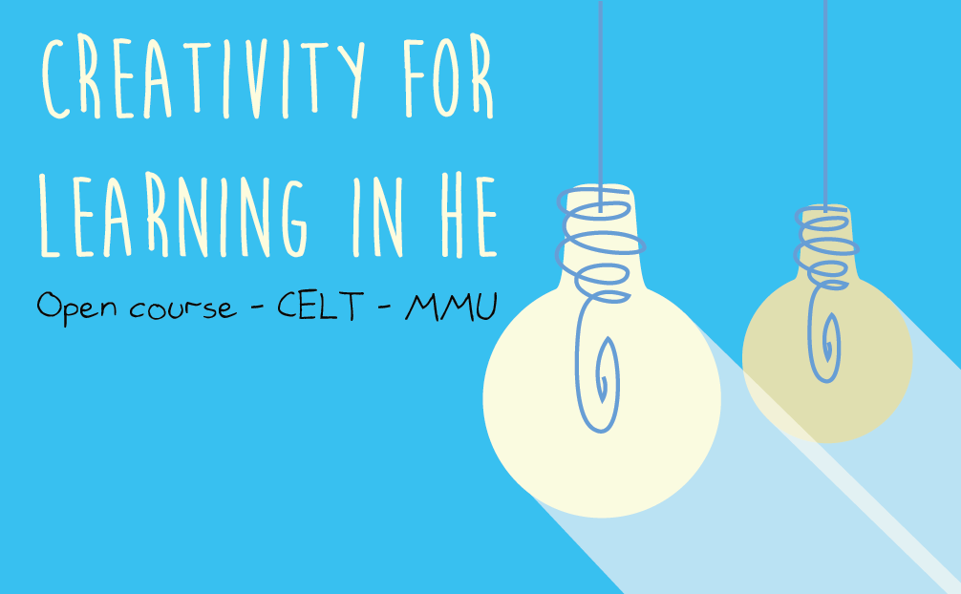
Notes:
The move to open courses and broader opportunities to develop

Slide 12
Notes:
Website and storify capture of the conversation

Slide 13
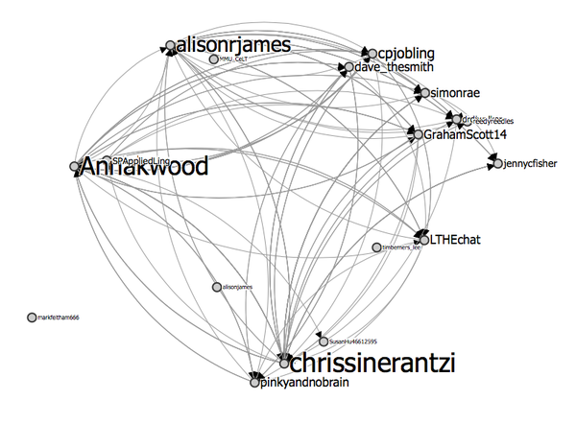

Slide 14
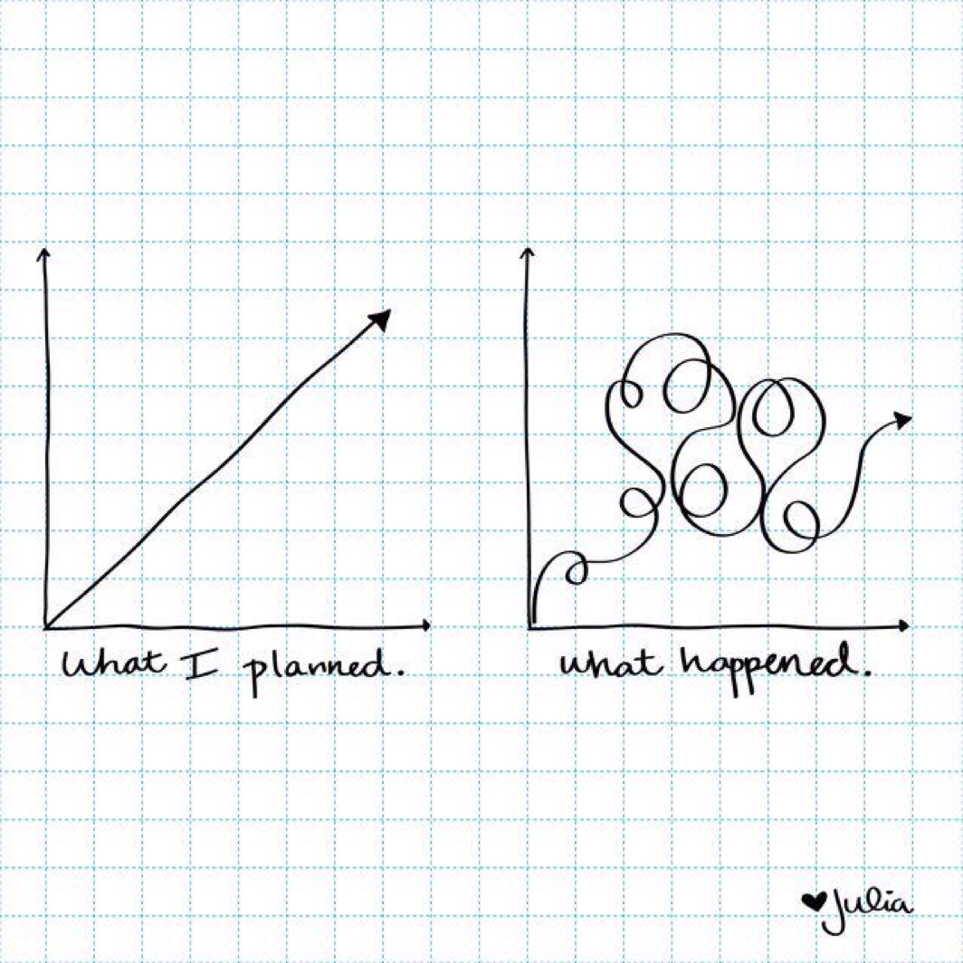
Innovation and risk in reflective practice
Notes:
Julia Gamolina’s life planning doodle, also used for project planning, can be used for our reflections on life as well as our reflections on our teaching

Slide 15
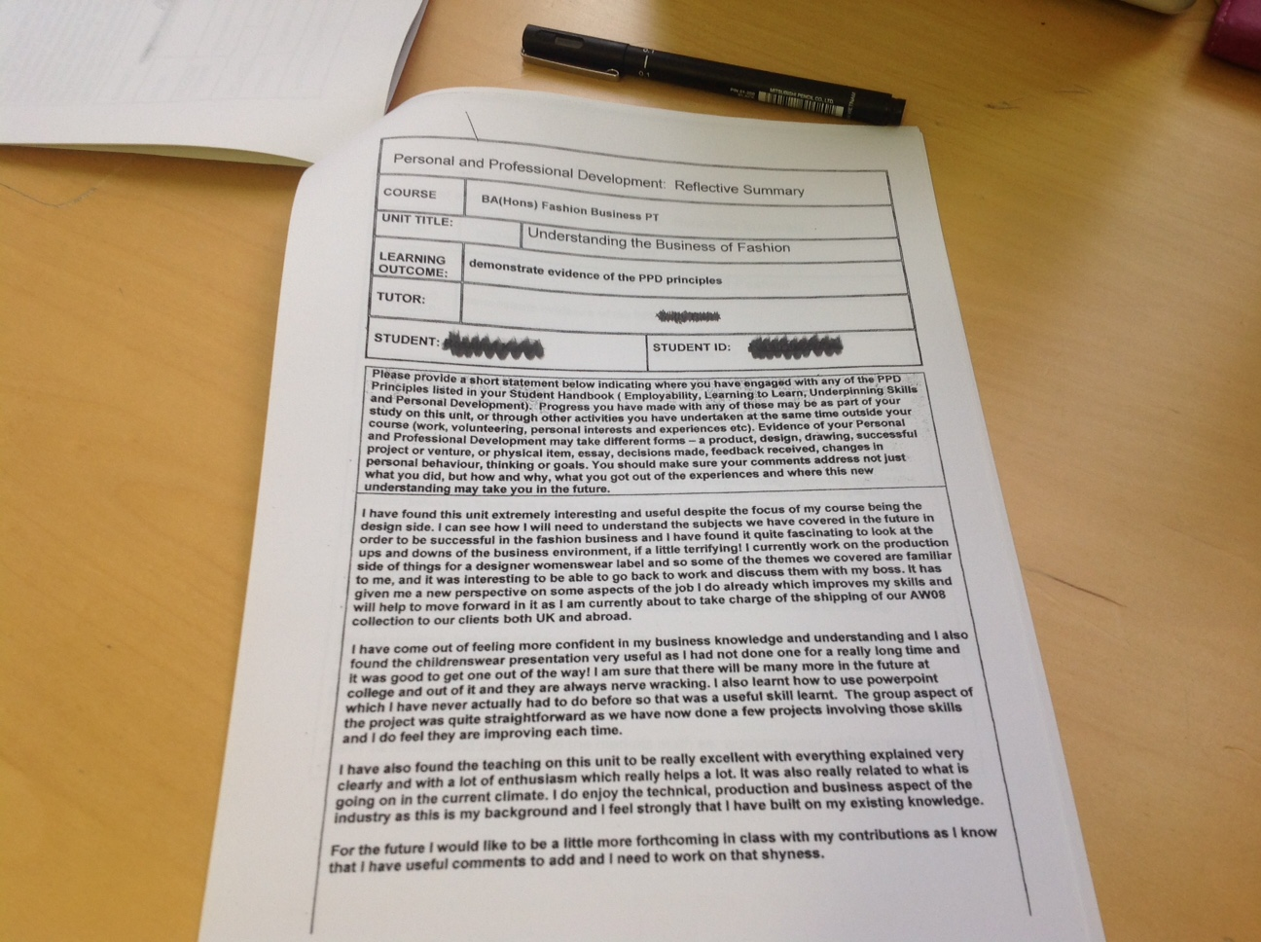

Slide 16
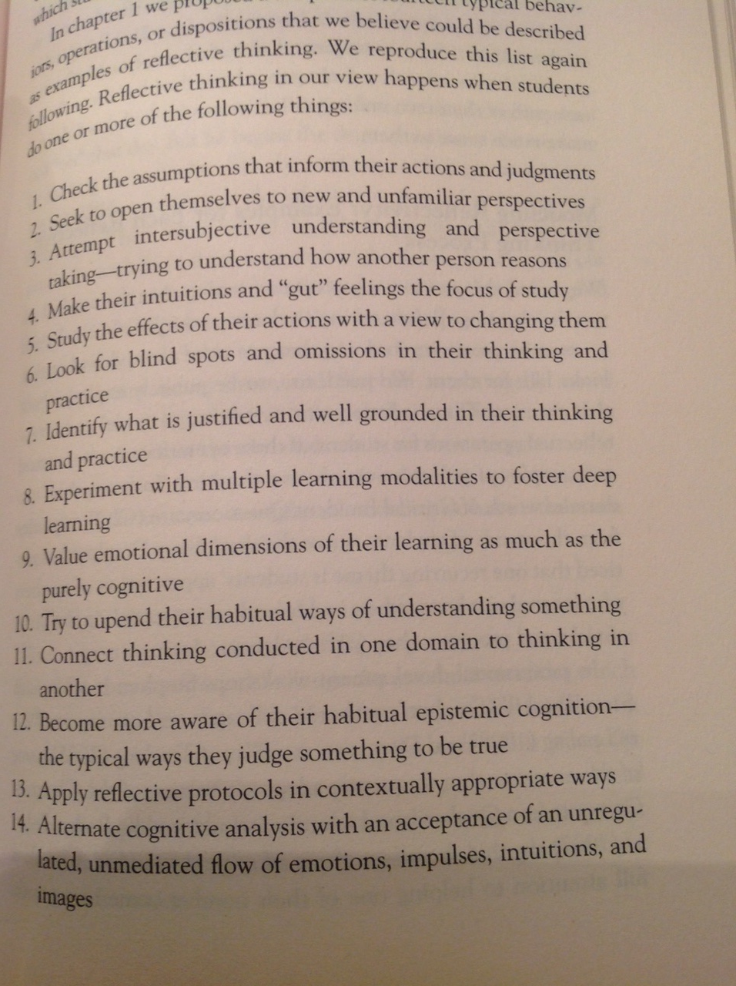
Notes:
Relative these to our teaching practice, particularly 1,2,3,5,6,7,8…no wait, all of them

Slide 17
Why we know we are different as disciplines
The hands are central to constructionist learning, based on neuroscientific data showing that nerve receptors in our fingers send electrical codes to the brain via our central nervous system. There, in the cerebral cortex, these messages are interpreted, thus we can envisage thinking as starting with our hands, as opposed to the popular assumption that the brain ‘thinks’ first and tells the hands to act.
(James, 2014, Altman & Concar, no date)
Notes:
This is how we know we are different, plus the hand brain complex that Wilson and others have identified are part of the hand-eye-brain triangulation, not to mention the other senses

Slide 18
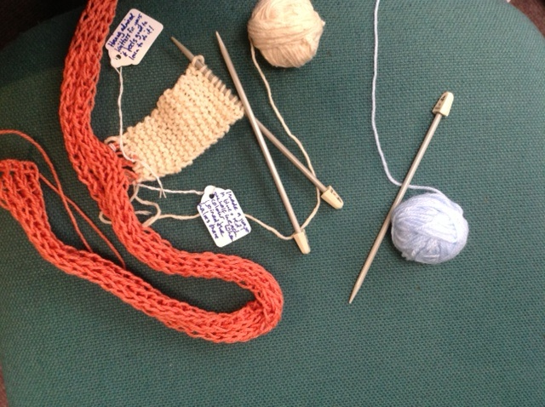

Slide 19
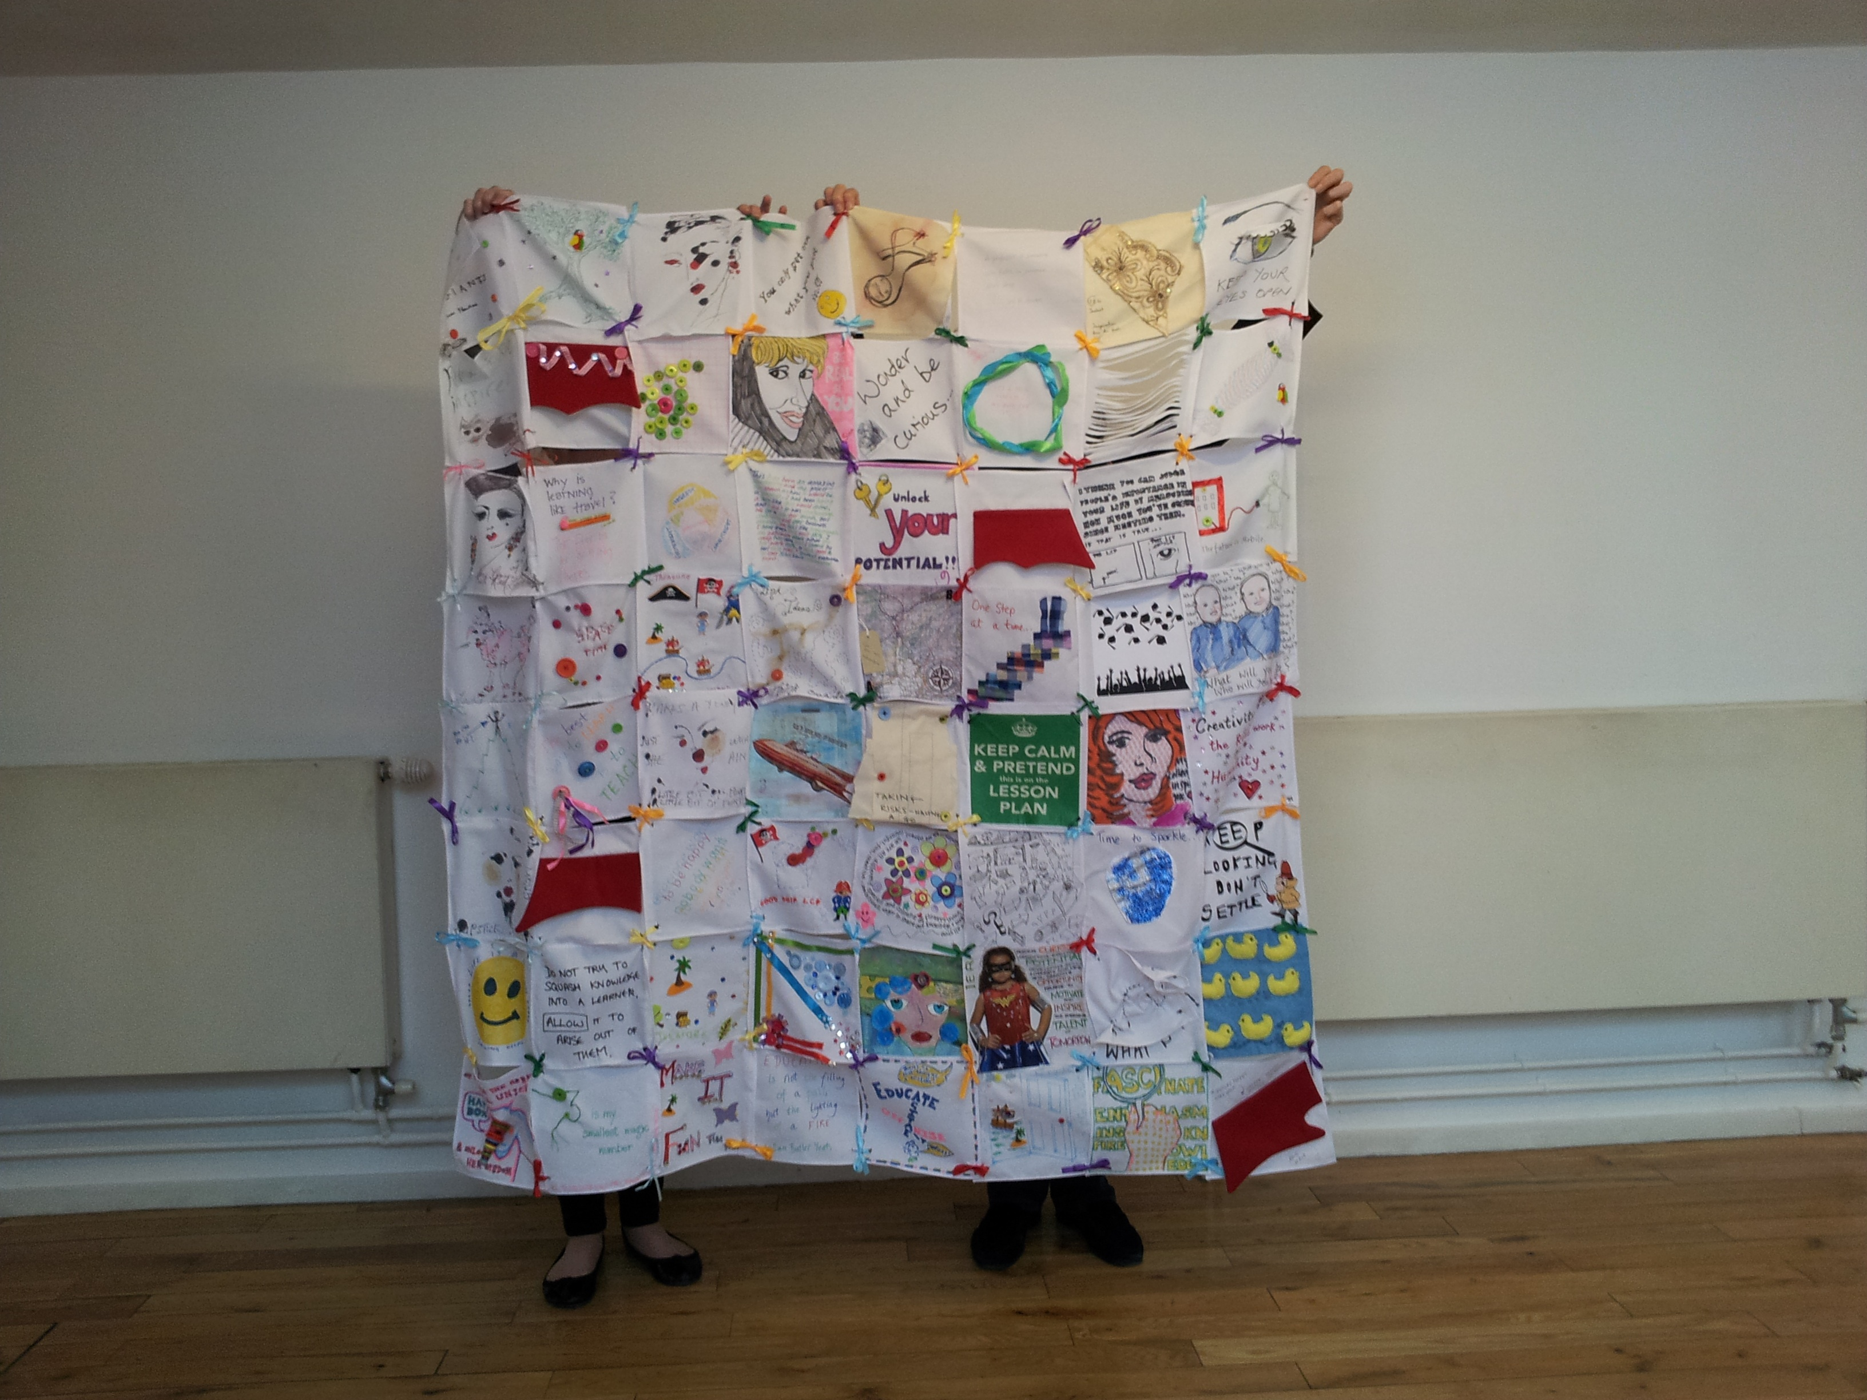

Slide 20
Lego Serious Play
…is a systematic set of techniques and applications which allow participants to explore complex issues or topics with no immediate obvious answer.
Each activity involves a four part process of posing a question, building, sharing and reflecting
Builders own the meaning in their model
Models can be individual and joint, small and large: whole landscapes of situations can be created

Slide 21
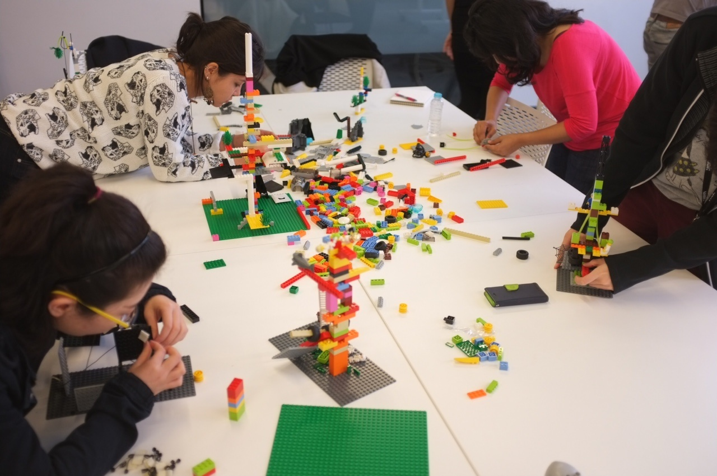

Slide 23
Things students found beneficial in creative modes of reflection
Using metaphor helped them think more creatively
Ways of listening and responding
Improved attention and concentration
Deepening of analysis of experience
The physical embodiment of the abstract and the concrete
Visualising actions and emotions
Planning next steps in 3D
Broadened English
Good for students with dyslexia/ADHD
international students felt more included
Relationship building

Slide 24
Risk
“…there are also challenges which can occur in other, non-traditional modes of learning: these may relate to newness, difference, preconceptions (“toys are for kids”) and the unexpected. Just as learning in informal spaces can either distract or encourage motivation, so learning through different modes may excite learners, or make them feel uneasy: sometimes too much freedom can scare off learners just as much as too little can stifle them”
(James, 2014)

Slide 26
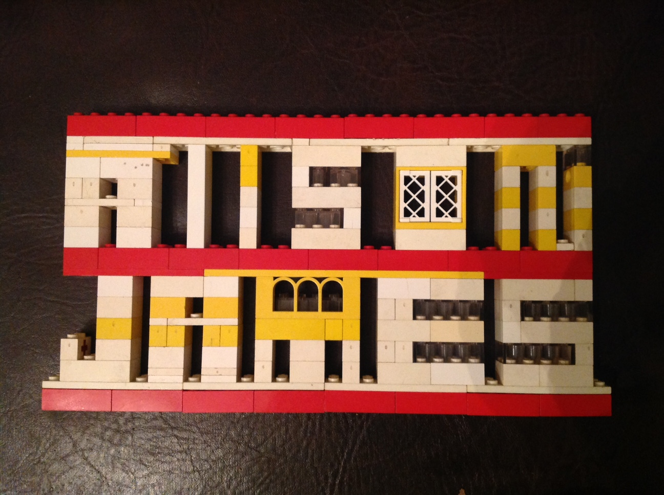
a.james@fashion.arts.ac.uk
http://www.engagingimagination.com
@alisonrjames

Slide 27
References
Altman & Concar, The Science of the brain. Michigan State University. Online.
James A, (2014) “Learning in Three Dimensions: Using Lego Serious Play for Creative and Critical Reflection Across Time and Space”. In Transgressing Boundaries. Eds. Layne P and Lake P. Springer.
James A and Brookfield S (2014) Engaging Imagination: helping students become creative and reflective thinkers. Jossey Bass.
LSP Facilitator Training Manual (2002, 2013)
Wilson F (1998) The Hand. Vintage Books.

