Slide 1
Health and Safety is your friend
Eleanor Pirie UAL Head of Health and Safety
Notes:
Hi my name is Eleanor Pirie, I am the head of health and safety for UAL. I was really excited to see todays topic as I believe the role of health and safety is to support innovation and risk.
I understand today is about encouraging students to take academic risks but my kind of risk is related to this, quite often when students are pushing academic boundaries they are also leaning quite heavily on health and safety ones.
Slide 1
Slide 2

Slide 2
Anything
is
Possible*
*Given enough resources
*and respecting the laws of physics
we’re good but not that good
Notes:
During this presentation I aim to challenge the common negative view of health and safety and, using a few examples of student’s work, illustrate my belief that H&S can be an enabler and not a barrier and that anything is possible
Even as an unashamed H&S groupie I have to admit that it has a pretty
negative press but why is this?
Slide 3

Slide 3
Shocking Exclusive!!!!!
Nothing went wrong
Health and Safety saved the day
In a shocking revelation Mrs Trellis of North Wales reveals it was a lovely event and everybody had a great time. !!!!!!!!!!!!!
Notes:
well ‘Daring event went off without a hitch and nothing went horribly wrong’ doesn't make for a very engaging headline.
On a slow news day amusing/outrage provoking stories about health and safety are rolled out along with benefit cheats and windsurfing budgies.

Slide 4
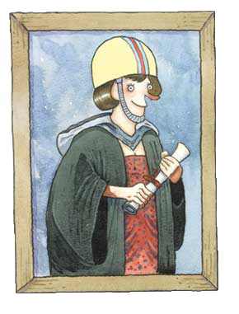
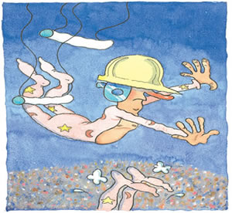
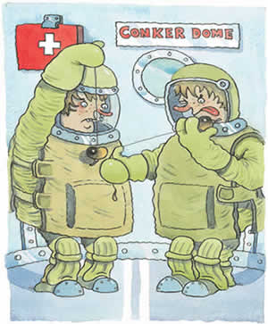
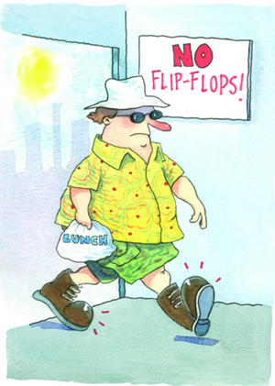
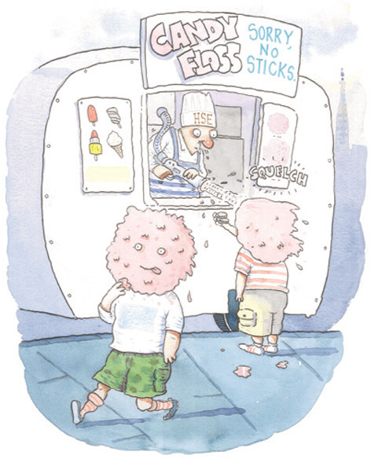
Can we be surprised that H&S has a negative press when some ‘examples’ are so ridiculous
Images from hse.gov.uk
Notes:
and windsurfing budgies. Do you remember any of these stories that made great headlines but were all either exaggerated, fabricated or health and safety was being used as an excuse.
This regular drip drip of mis-information and lazy reporting has resulted in a general acceptance that health and safety will always have a negative effect,

Slide 5
In 2014 at UAL there were
students involved in
3 catwalk shows and
25+ exhibitions attracting
100 000+ visitors
Notes:
make things more difficult and costly, and require unnecessary paperwork and waste time.
but H&S law is written to be supportive, we are lucky in the UK that we have risk assessment, there are very few hard and fast rules, making virtually anything possible and its a great planning tool Slide 6

Slide 6
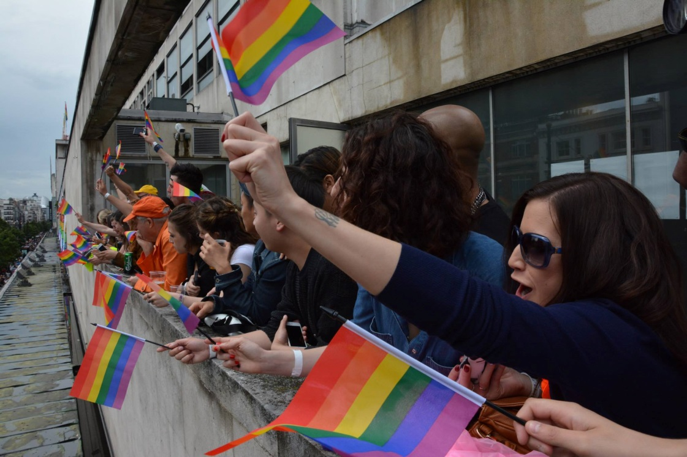

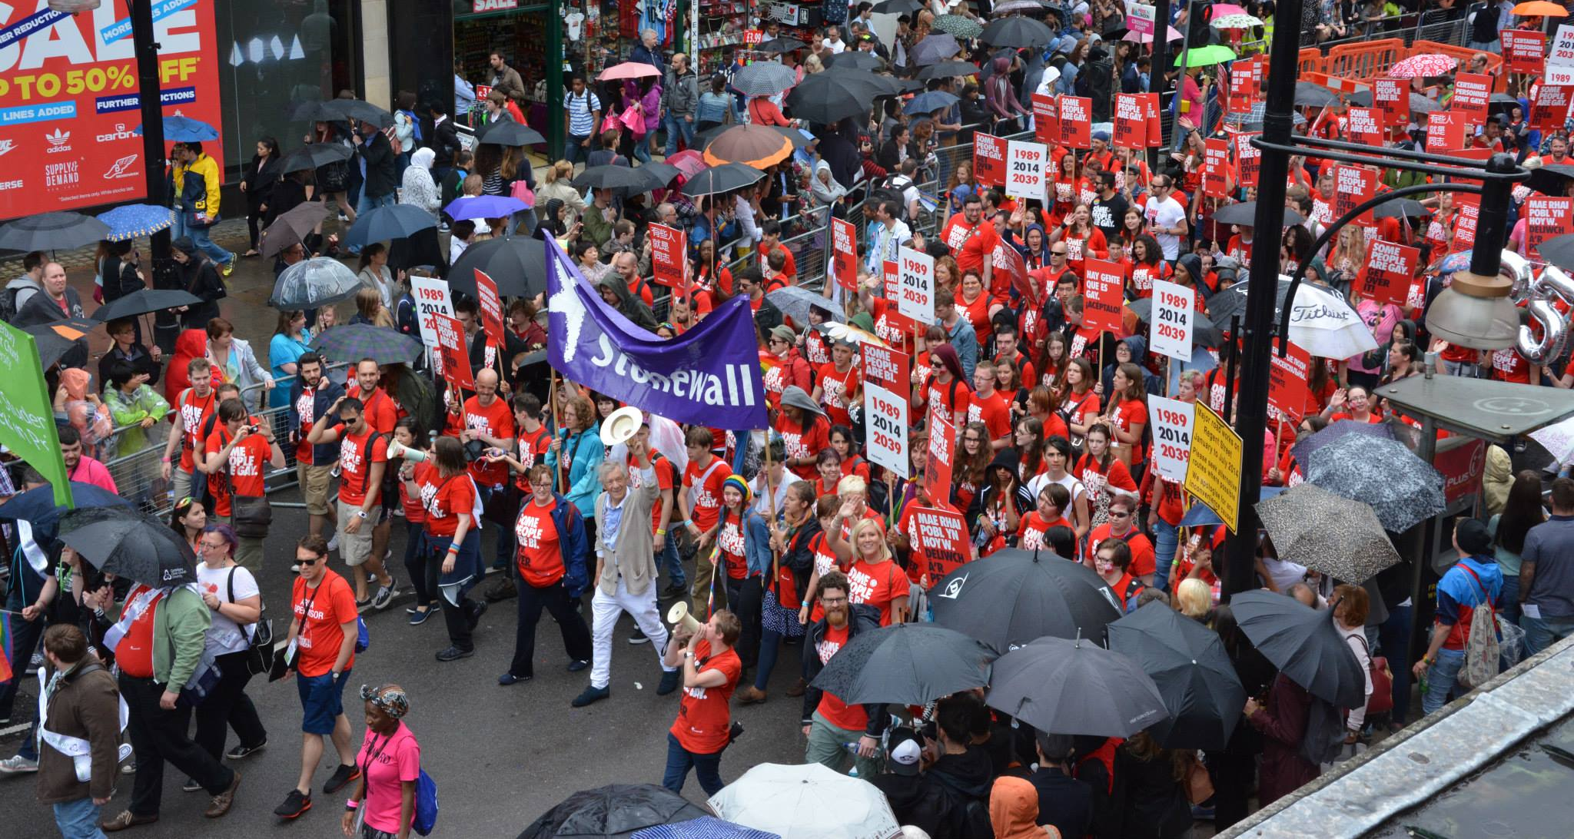
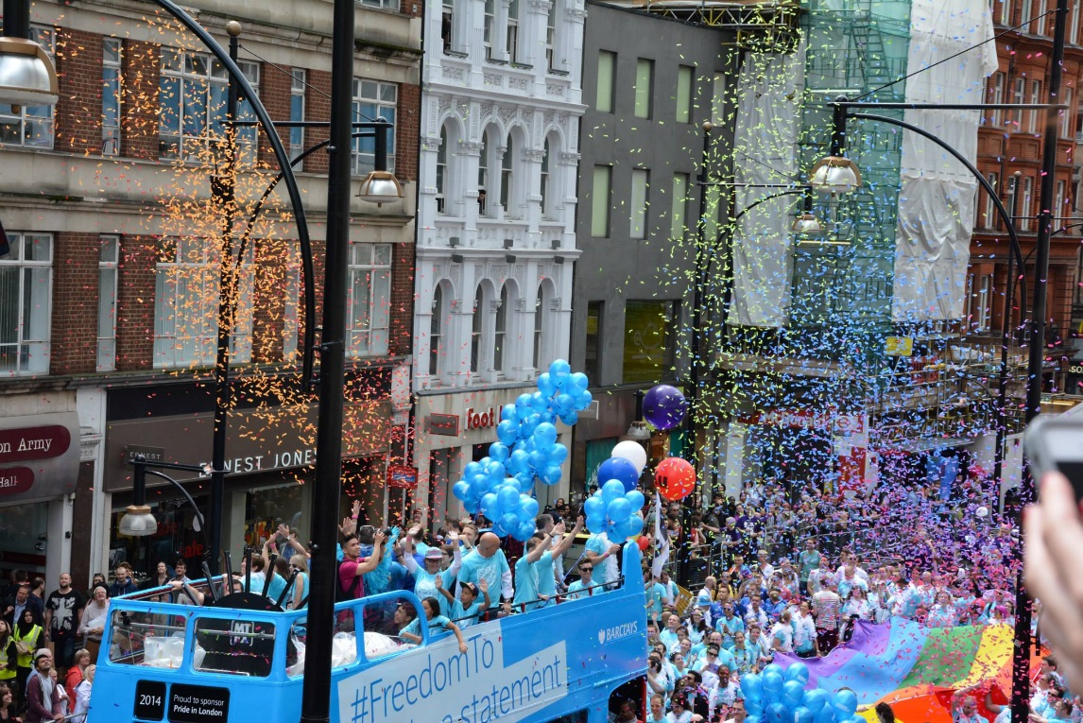
Images from ArtsPride2014
Notes:
with the added bonus the potential to save money, time, injury, illness and death. Pretty much win win all round.
To illustrate my point I have the following examples.
Last year the first LCF/ Pride Event was held at JPS.

Slide 7
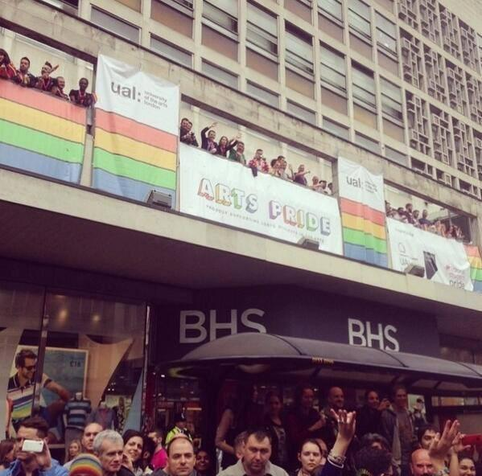
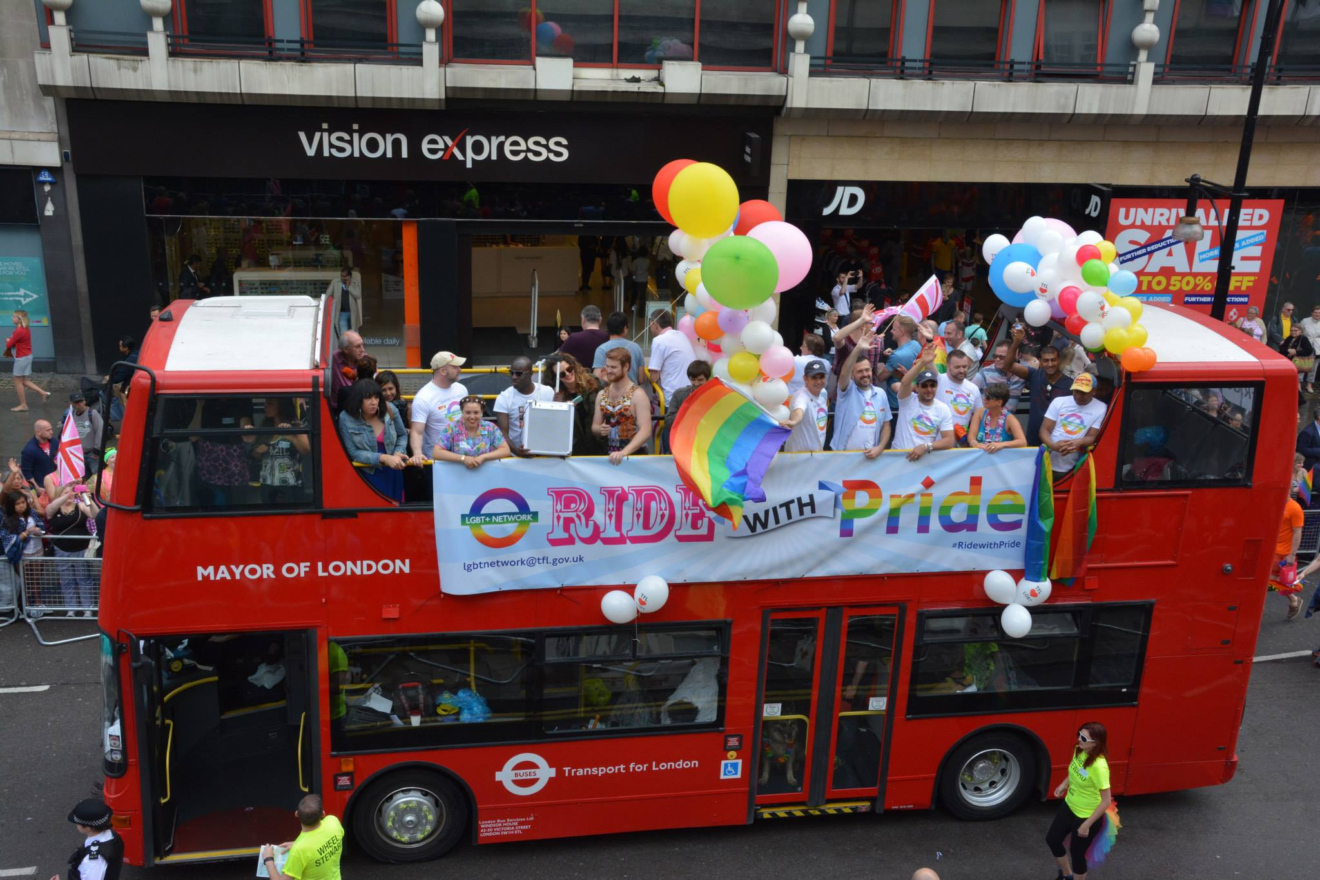
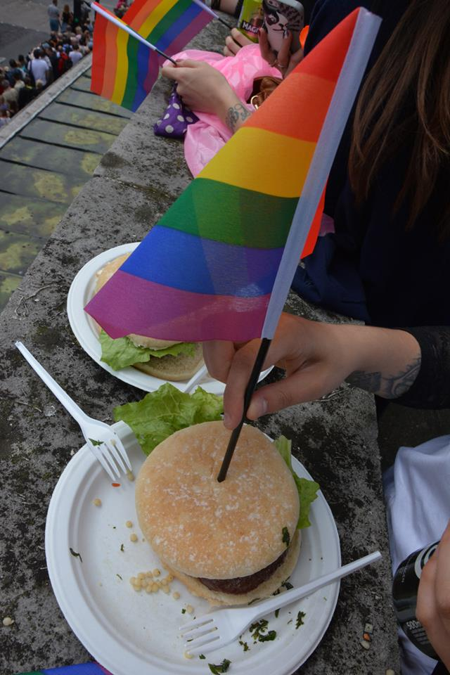
Images from ArtsPride2014
Notes:
A party was organised by two students, one of them a first year. The event was open to any student from any university, it was ticketed and catered. To pull this off the students liaised with the H&S Adviser, the estates team and other LCF staff but the organisation, planning, licensing and risk assessment was managed by them. Slide 7

Slide 8
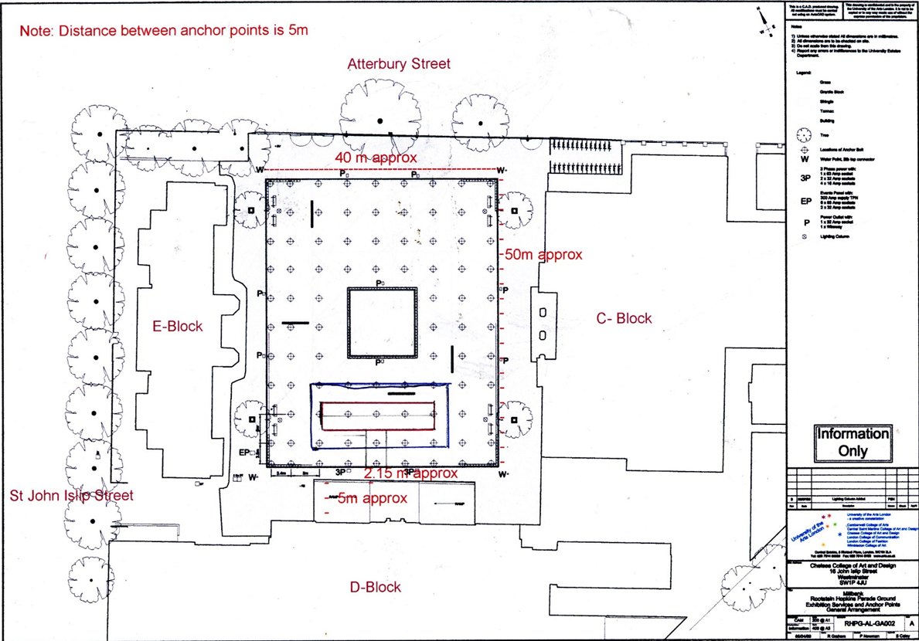
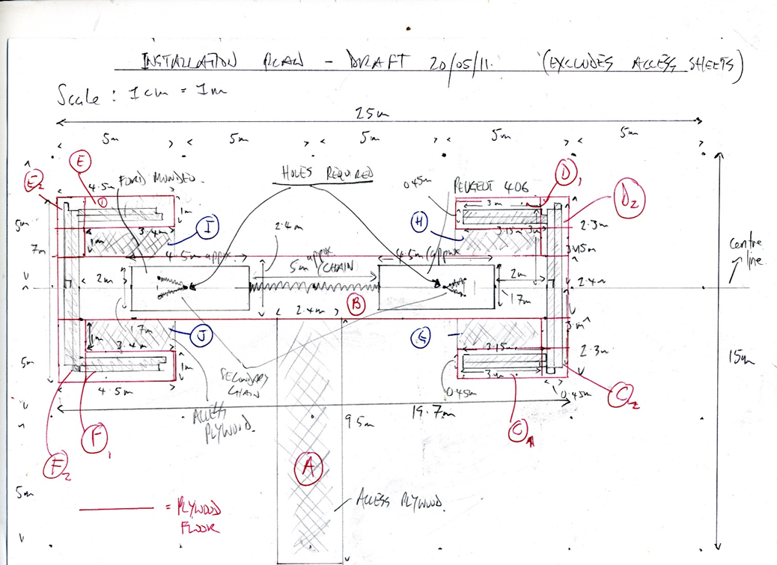
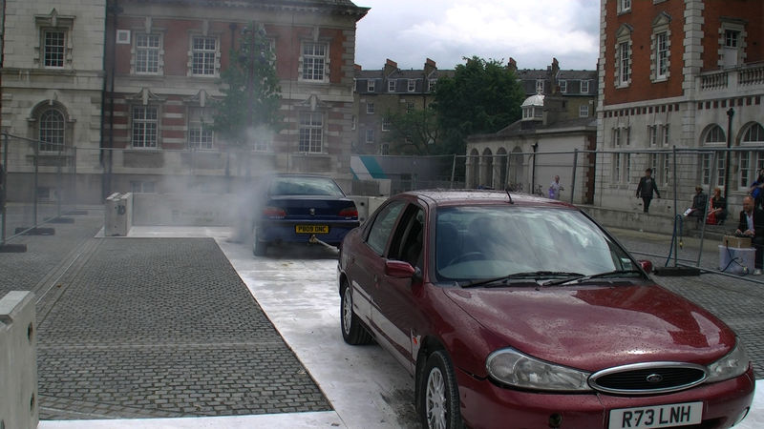
If only only if
Video still from if only only if copyright James White
Notes:
150 people attended, there were no reported incidents, everyone had a good time and left safely.
Or consider this;
Two ‘real’ remote control cars on the Chelsea Parade Ground pulling against each other in a tug of war. The student who made this piece engaged engineers to calculate the size of chain needed and the positioning of crash barriers. Slide 8

Slide 9

http://www.flaticon.com/free-icon/sedan-car-side-view_48301
Notes:
He modified the cars, worked out audience positions and convinced the College it wasn’t going to destroy the parade ground.
During the event the cars did break free but because they were individually tethered neither of them crashed into the barrier or bystanders.
Lastly three full-size horses made from wire suspended above the Street at Kings Cross Slide 9
Slide 10

Slide 10

Horses at Kings Cross
http://www.flaticon.com/free-icon/horse-standing-on-three-paws-black-shape-of-side-view_35922
Notes:
Wires were slung across the width of the space from a service walkway. The weight of the horses and therefore the load bearing requirements of the wire and fixings was calculated, the sculptures were suspended and moved into place and remained there through out the degree show.

Slide 11
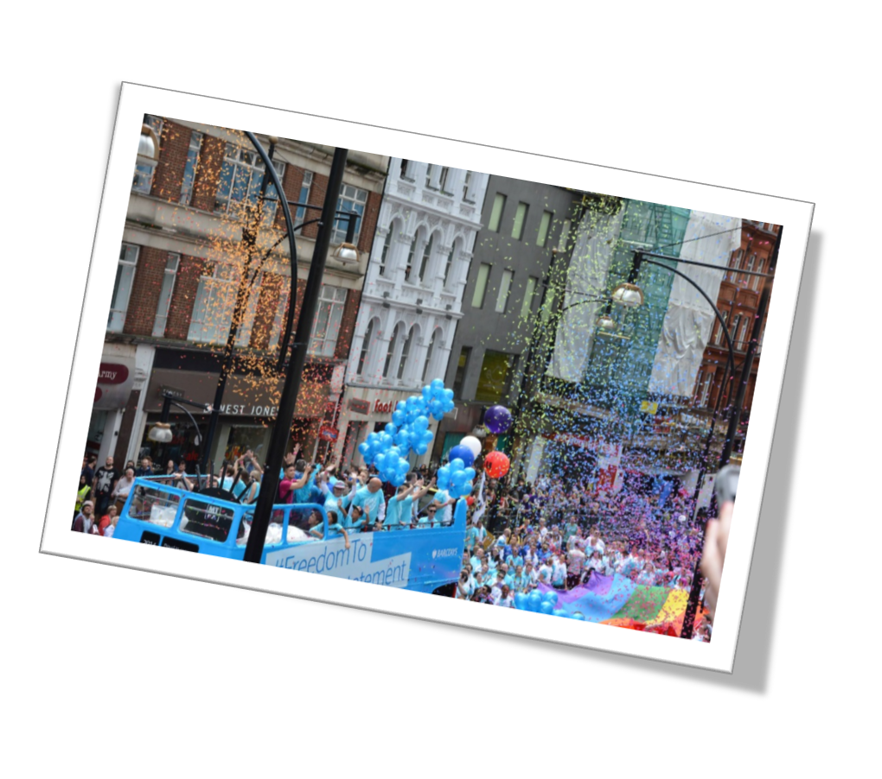
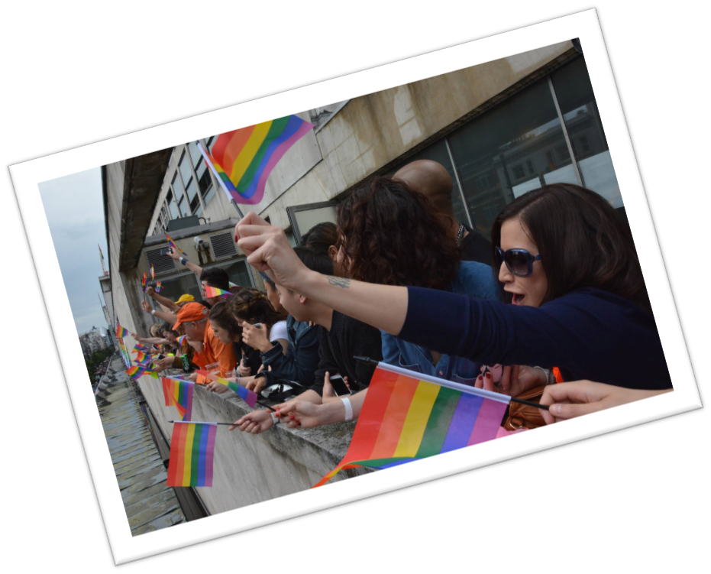
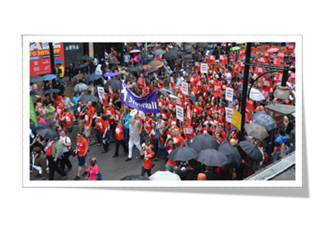


Notes:
Okay I'm not pretending that health and safety was the primary reason for the creation and success of any these amazing projects but good, timely risk assessment and H&S planning enables our students to take risks and contributed to the success of these and many other projects.
Slide 11

Slide 12

BOMB
http://www.flaticon.com/free-icon/school-bag_66025
Notes:
There are also examples of when H&S wasn’t considered and things have gone wrong. Usually this results in some lost time; a student planted a fake bomb in the reception at Back Hill to see what the reaction would be, the building was evacuated, the police were not amused;
Private views have been ruined; a student planned to use a horse in their final show, didn’t tell the college Slide 12

Slide 13

http://www.flaticon.com/free-icon/silhouette-of-a-man-riding-a-horse_8651
Notes:
do a risk assessment planning to take the horse through corridors and up stairs to get to the venue, they arrived 30 minutes before the final show opened. The horse wasn’t allowed in.
Occasionally things are more serious and people get hurt. In 2012 a student was experimenting with explosive black powder Slide 14

Slide 14
Bang
Notes:
they miscalculated and sustained injuries to their face, chest and hands, thankfully not permanent.
In 2013 a student at Chelsea was preparing her graduating show working at height on her own when she fell. luckily her fall was broken by a table and she only dislocated Slide 15

Slide 15

http://www.flaticon.com/free-icon/paratrooper-falling-silhouette_38661
Notes:
and fractured her wrist.
Despite these examples I hope I have been persuasive that health and safety is an enabler to risk and innovation. Each College has a health and safety adviser but the resource they can provide to individuals is limited. the main source of advice and support for students is always

Slide 16
h&s@arts
I need to………..
Do a risk assessment
Carry out primary risk assessment
Organise a location shoot
Organise an event
Notes:
to be from tutors and technicians. To improve the resources and support available to you and your students there is a website specifically designed for UAL students. The content reflects what students need for their courses but it is limited; I would really like to grow the site with loads more content and examples of assessments,

Slide 17
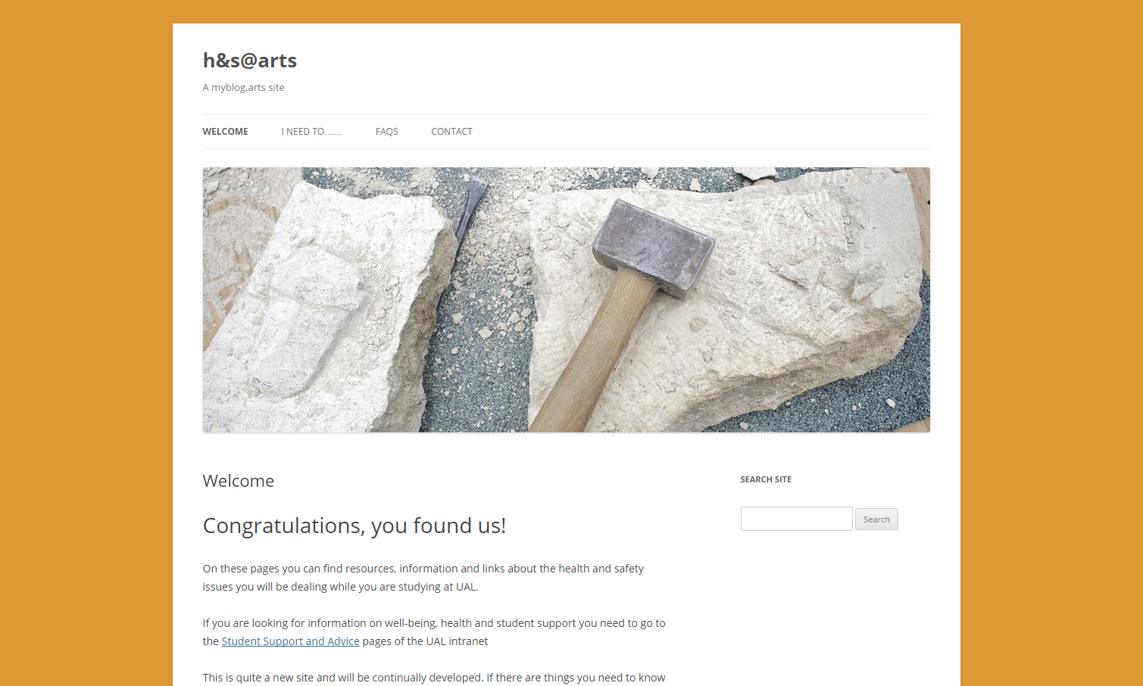
Snip from web site

Slide 18
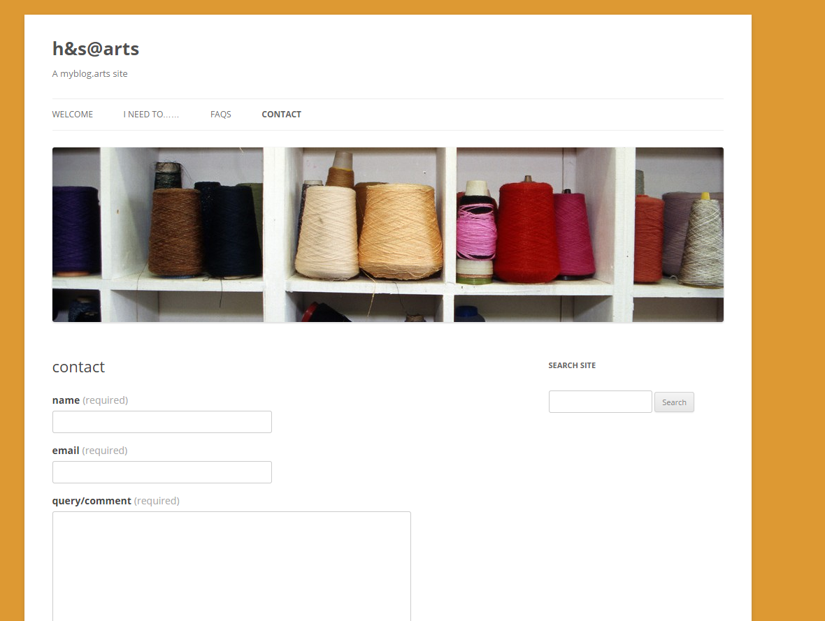

Slide 19
Every year UAL staff and students do amazing things
Health and safety supports this
Anything is possible.
students involved in
3 catwalk shows and
25+ exhibitions attracting
100 000+ visitors

Slide 20
Thank you for listening
Attributions
Thank you to:
Brookie Fraser Jenkins LCF Health and Safety Adviser
Niall Campbell CSM Health and Safety Adviser
Abigail Dickinson CCW Health and Safety Adviser
James White - If only only if
Blake Field – Pride Arts
Flat icons from www.flaticons.com
Slide 4 images www.hse.gov.uk

