Slide 1
Whose space is it anyway?
Improvisational use of learning spaces
Suzanne Rankin – Dia
International Preparation for Fashion
London College of Fashion
s.rankin@arts.ac.uk

Slide 2
The Inspiration
Quest for space - busy lifestyles
LCF ‘Time to Think’ – building a community sensory garden at Cody Dock (GDP)

Slide 3
Cody Dock
Community Sensory Garden

Slide 4
The Context
International preparation for Fashion (IPF) = 237 students from all over the world
Academic Language and Communication (ALAC) – wide range of language ability

Slide 5
The Class
The unit is not streamed but supported in smaller groups for language development

Slide 6
The Theory
Smooth and striated space (Deleuze and Guattari, 1988)
Smooth space is open space, which can be ‘nomadic’, in opposition to the striated, which is space of closure – ‘sedentary’, bordered ‘state’ space.

Slide 7
Striated learning space
Outcome-driven, functional and uncontested
‘a sense of subordination to a body of knowledge…students will be expected to learn and subsume disciplinary practices, rather than challenge them’ (Savin-Baden, 2008)

Slide 8
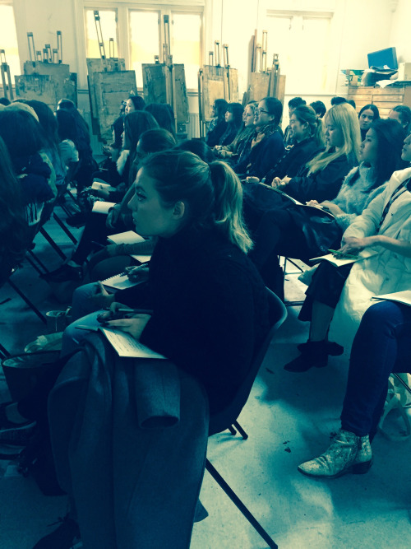
Striated learning space

Slide 9
Smooth learning space
Contested - focuses on the student journey
‘open, flexible and contested spaces…students here would be encouraged to contest knowledge and ideas proffered by lecturers’ (Savin-Baden, 2008)

Slide 10
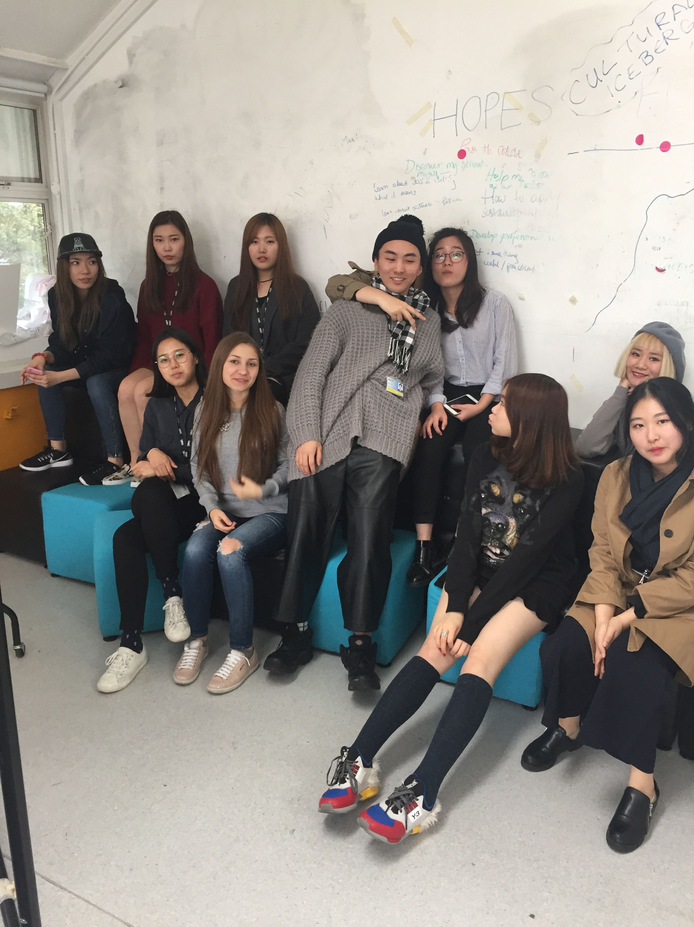
Image of space created by students for the same purpose
Smooth learning space

Slide 11
The IPF learning space
Mare Street – sense of intimacy
Space aligned to a function and labeled as such
ALAC does not have a designated space

Slide 12
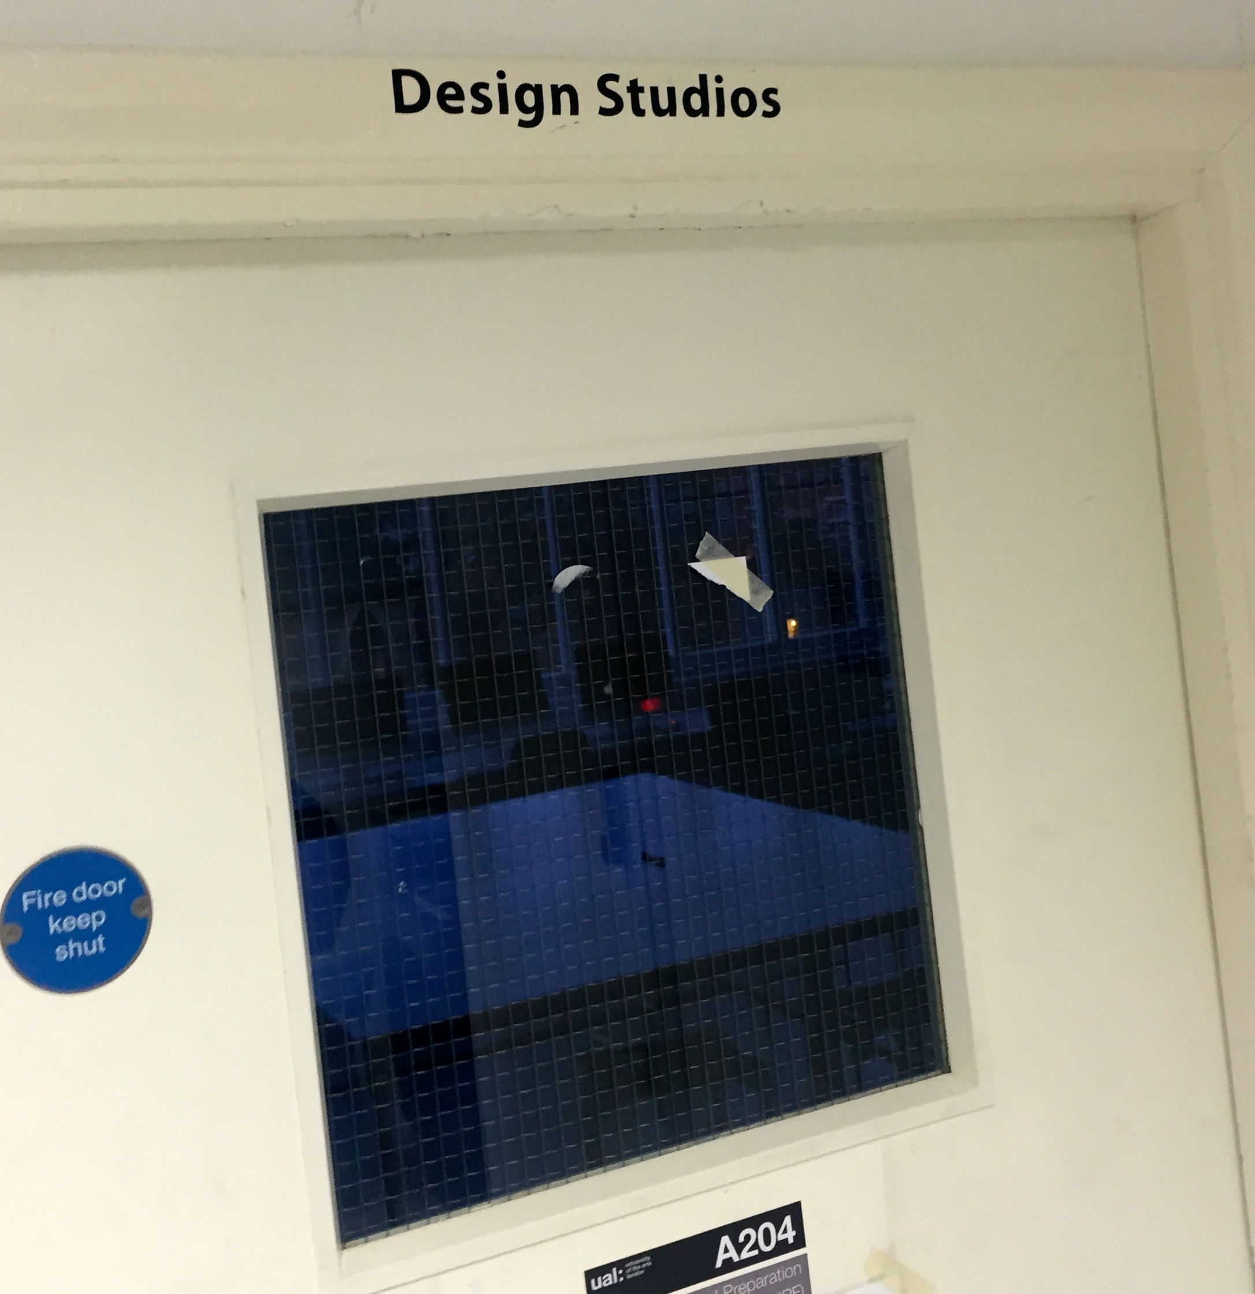
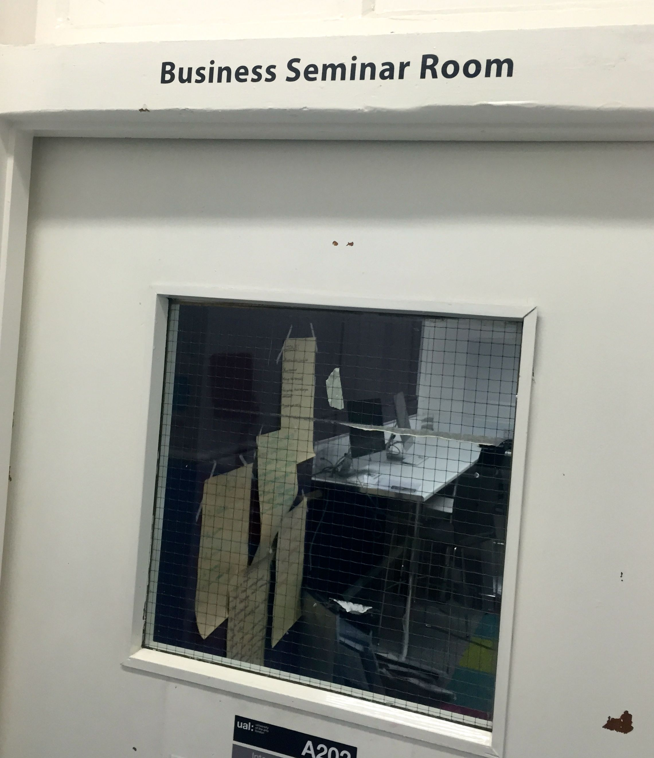
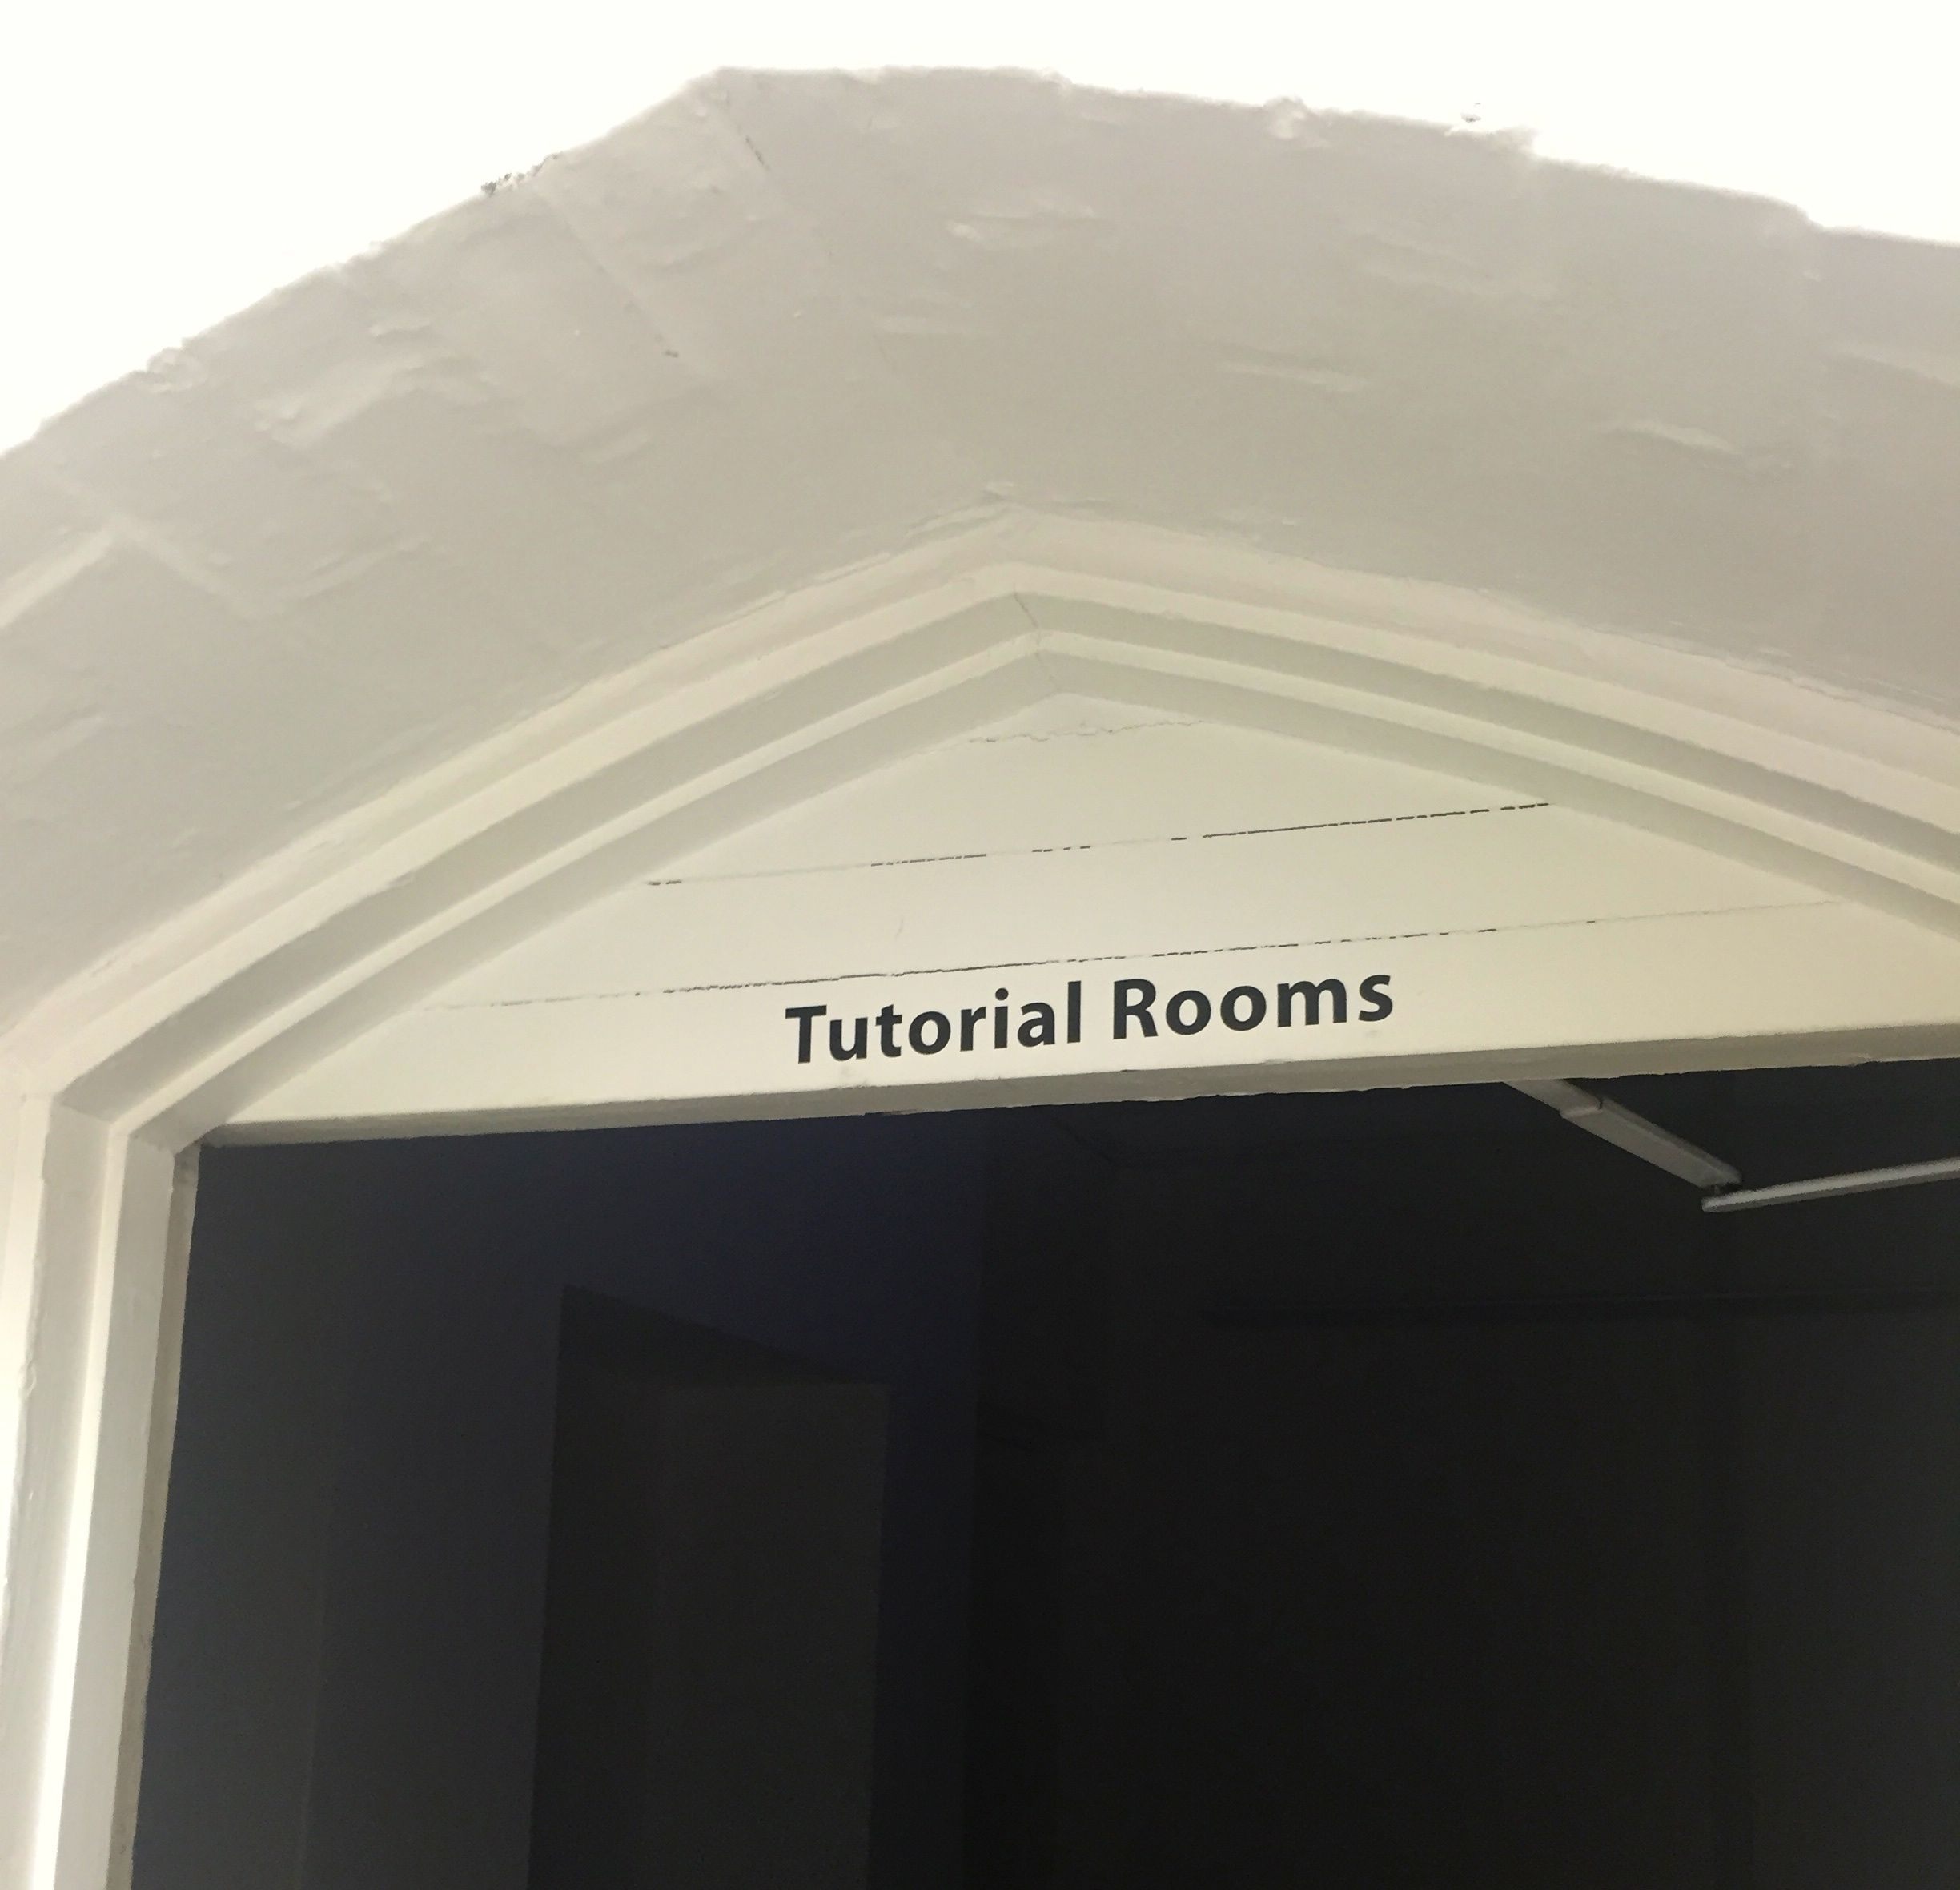
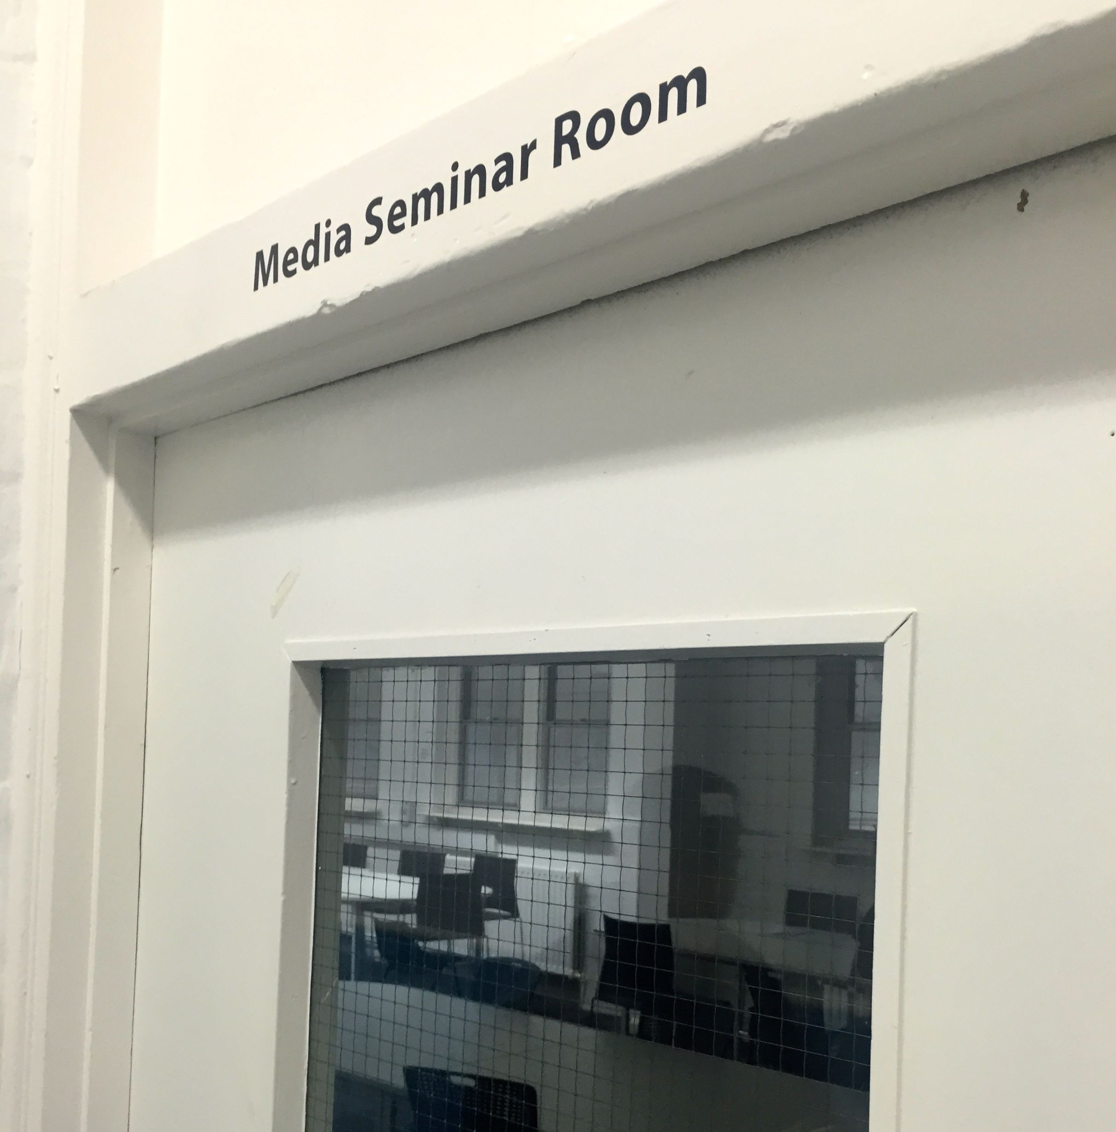
Mare street learning spaces labeled according to function

Slide 13
The practice
Happy accident – A101 – ‘the drawing room’
Students designed and created their ‘ideal classroom’
Began applying this as part of every session – to include negotiation, collaboration and intercultural communication in practice

Slide 14
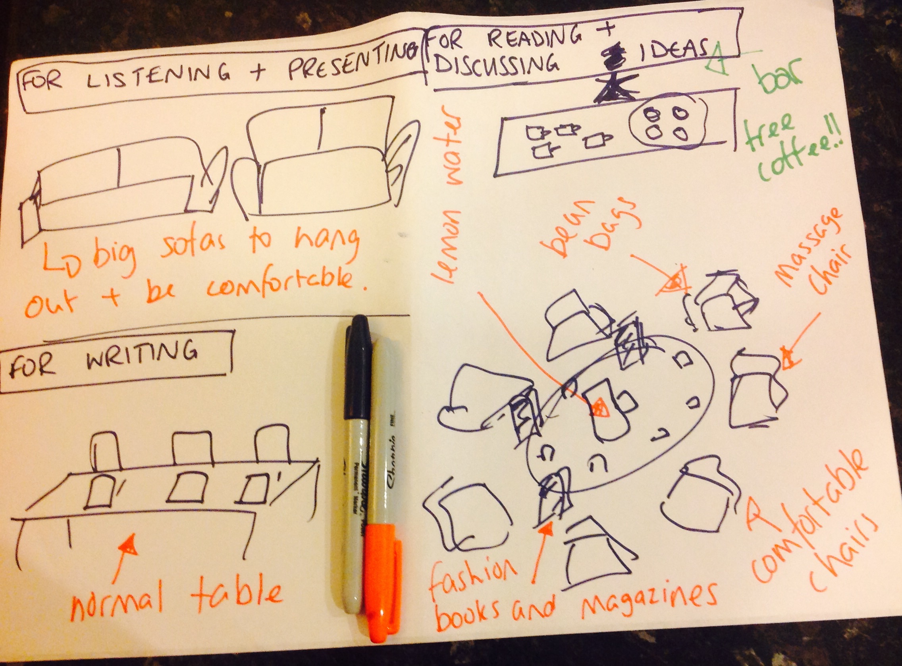
The ideal classroom…
Image of students plans

Slide 15
The outcomes
Students take control of the physical space and create a negotiated space that reflects their needs as a group
Smooth spaces created within a striated space dependent on the learning outcomes of a given session
Transferrable nomadic space is created

Slide 16
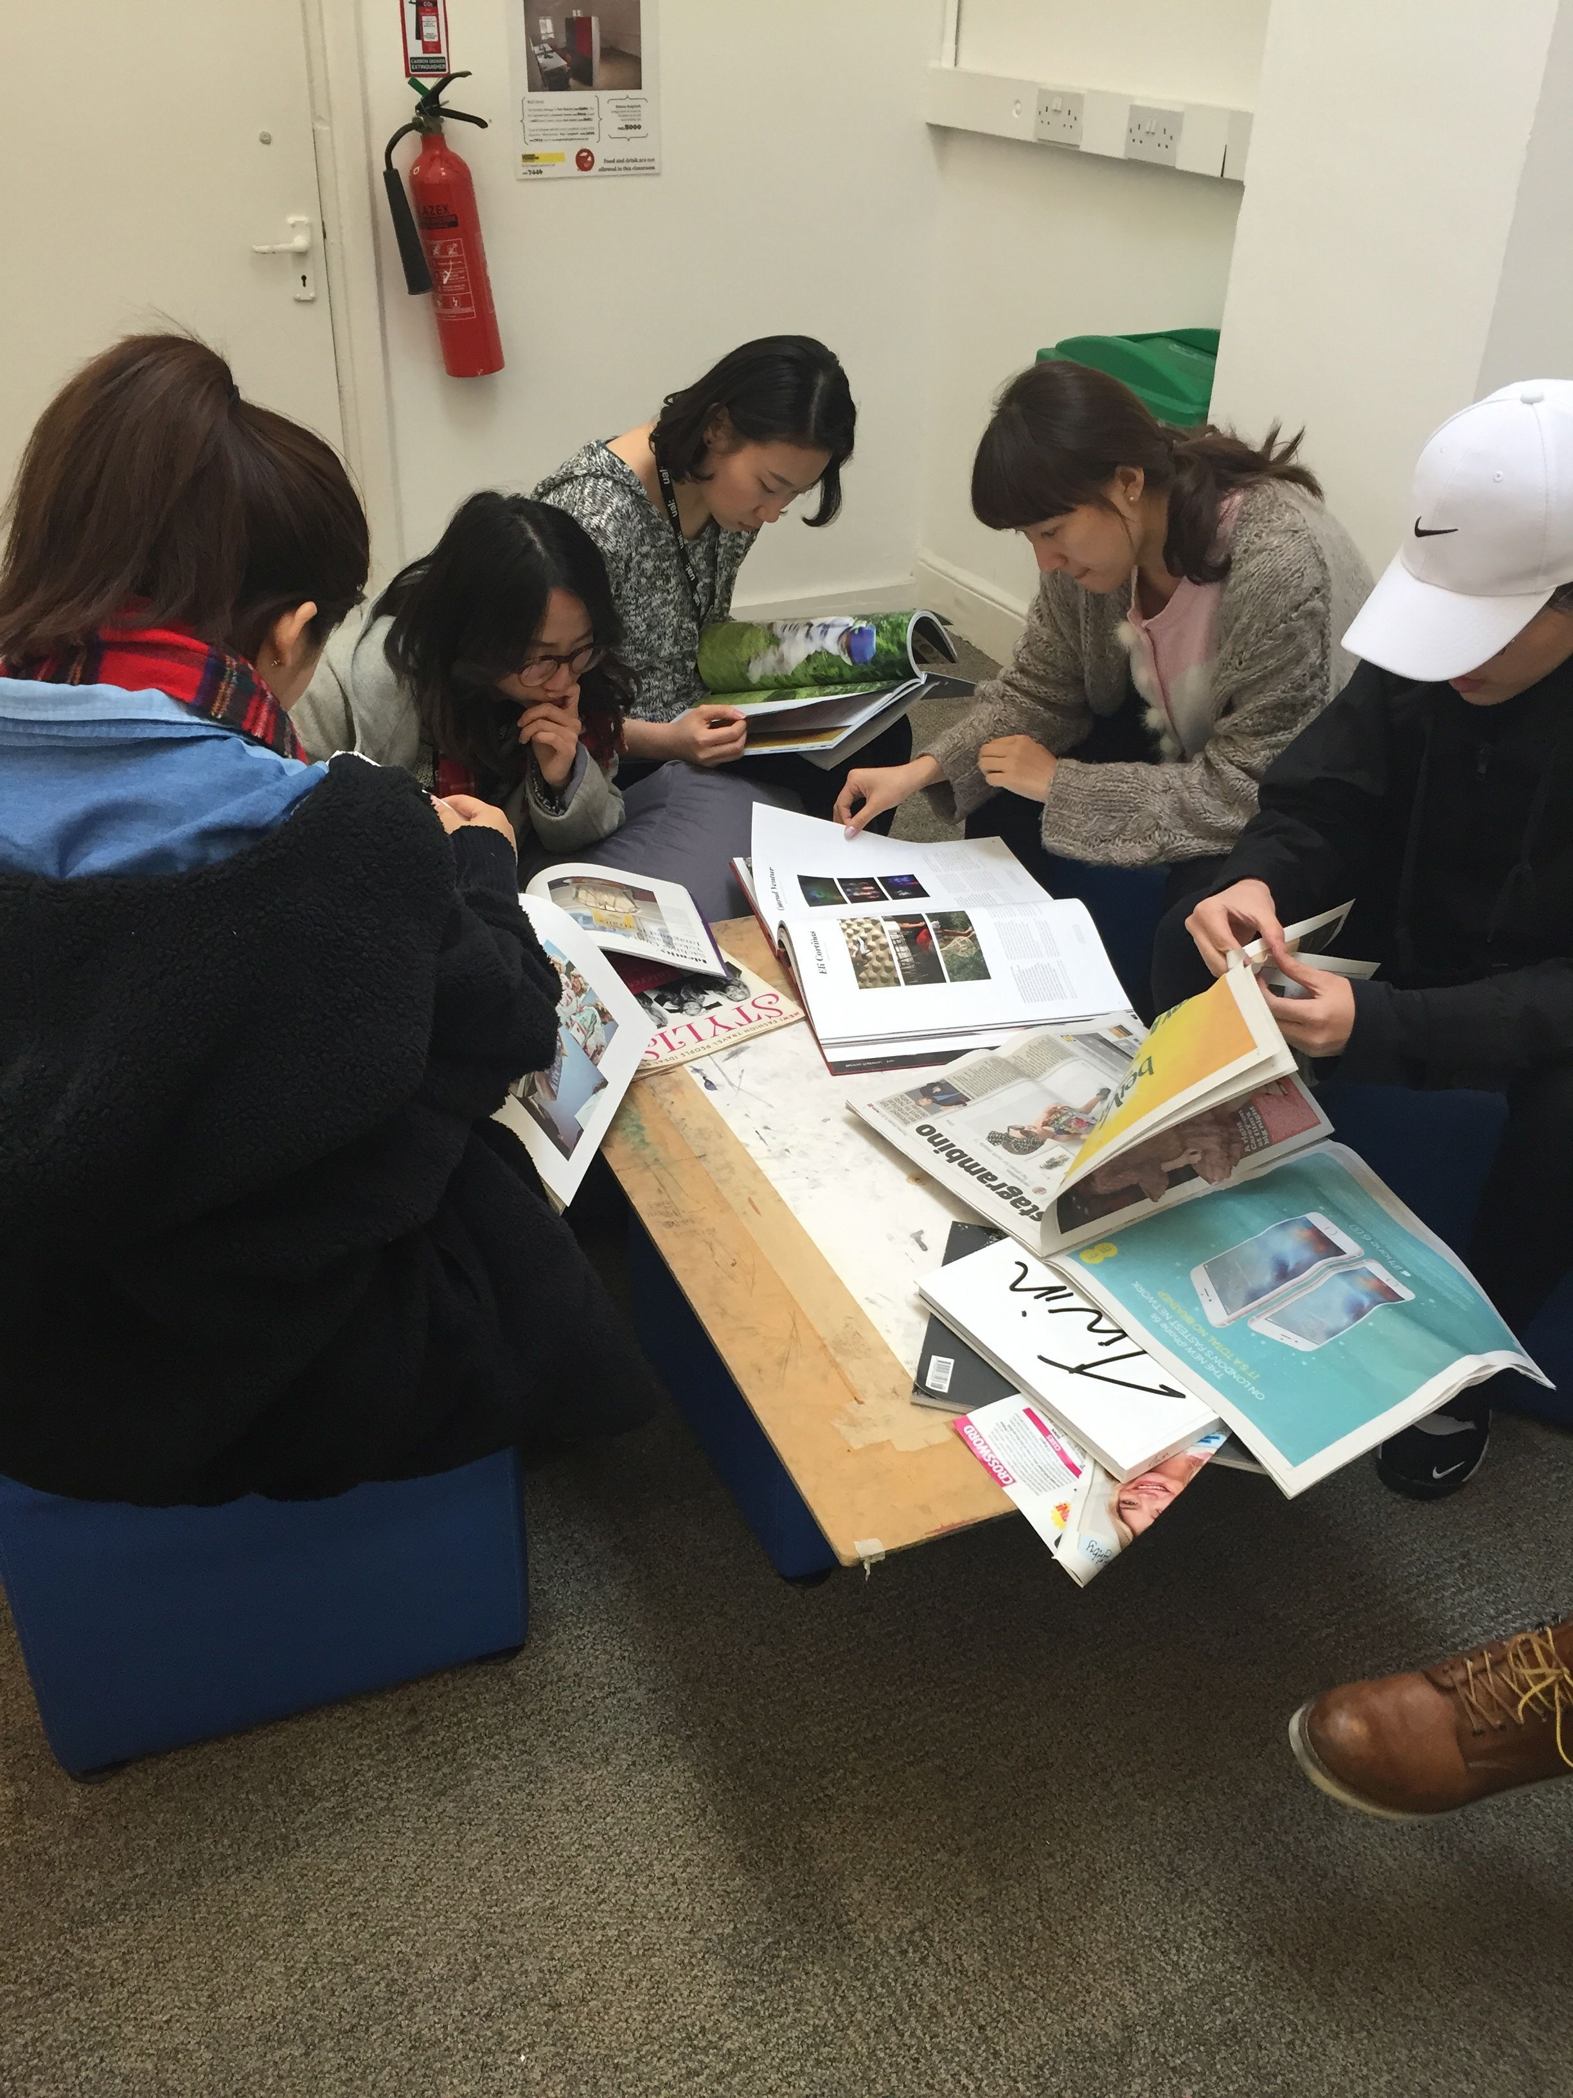
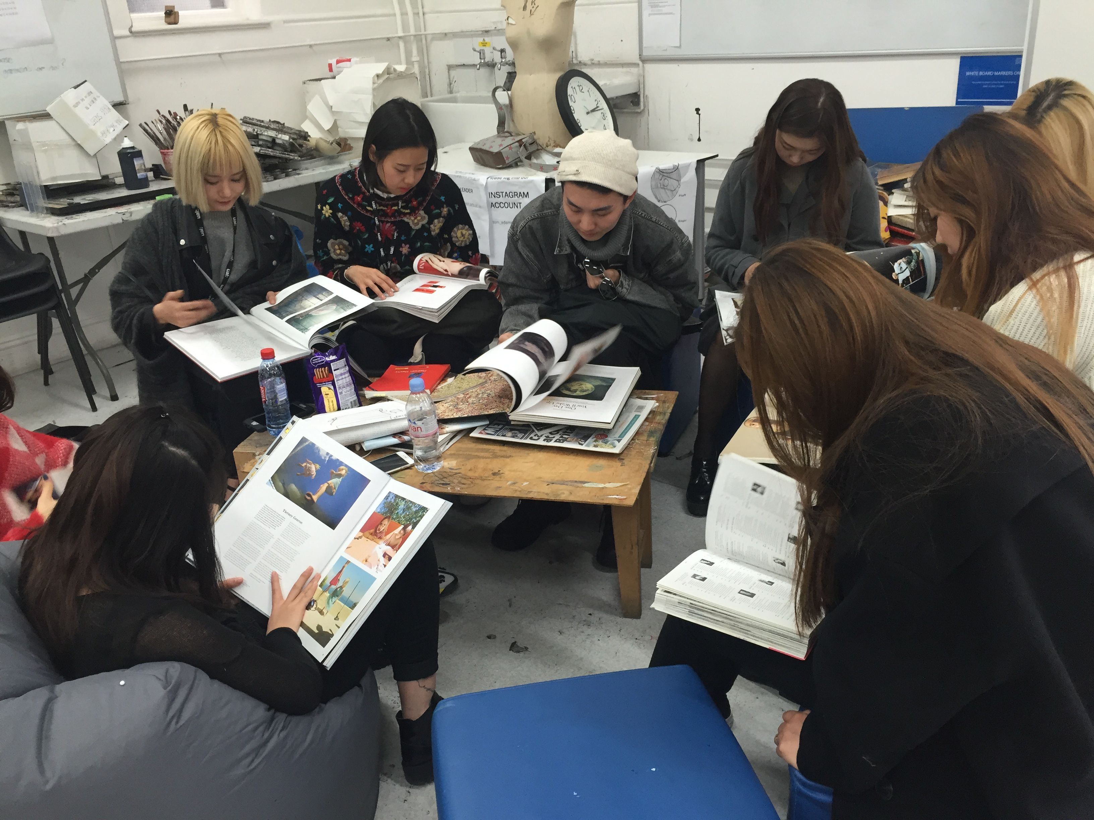
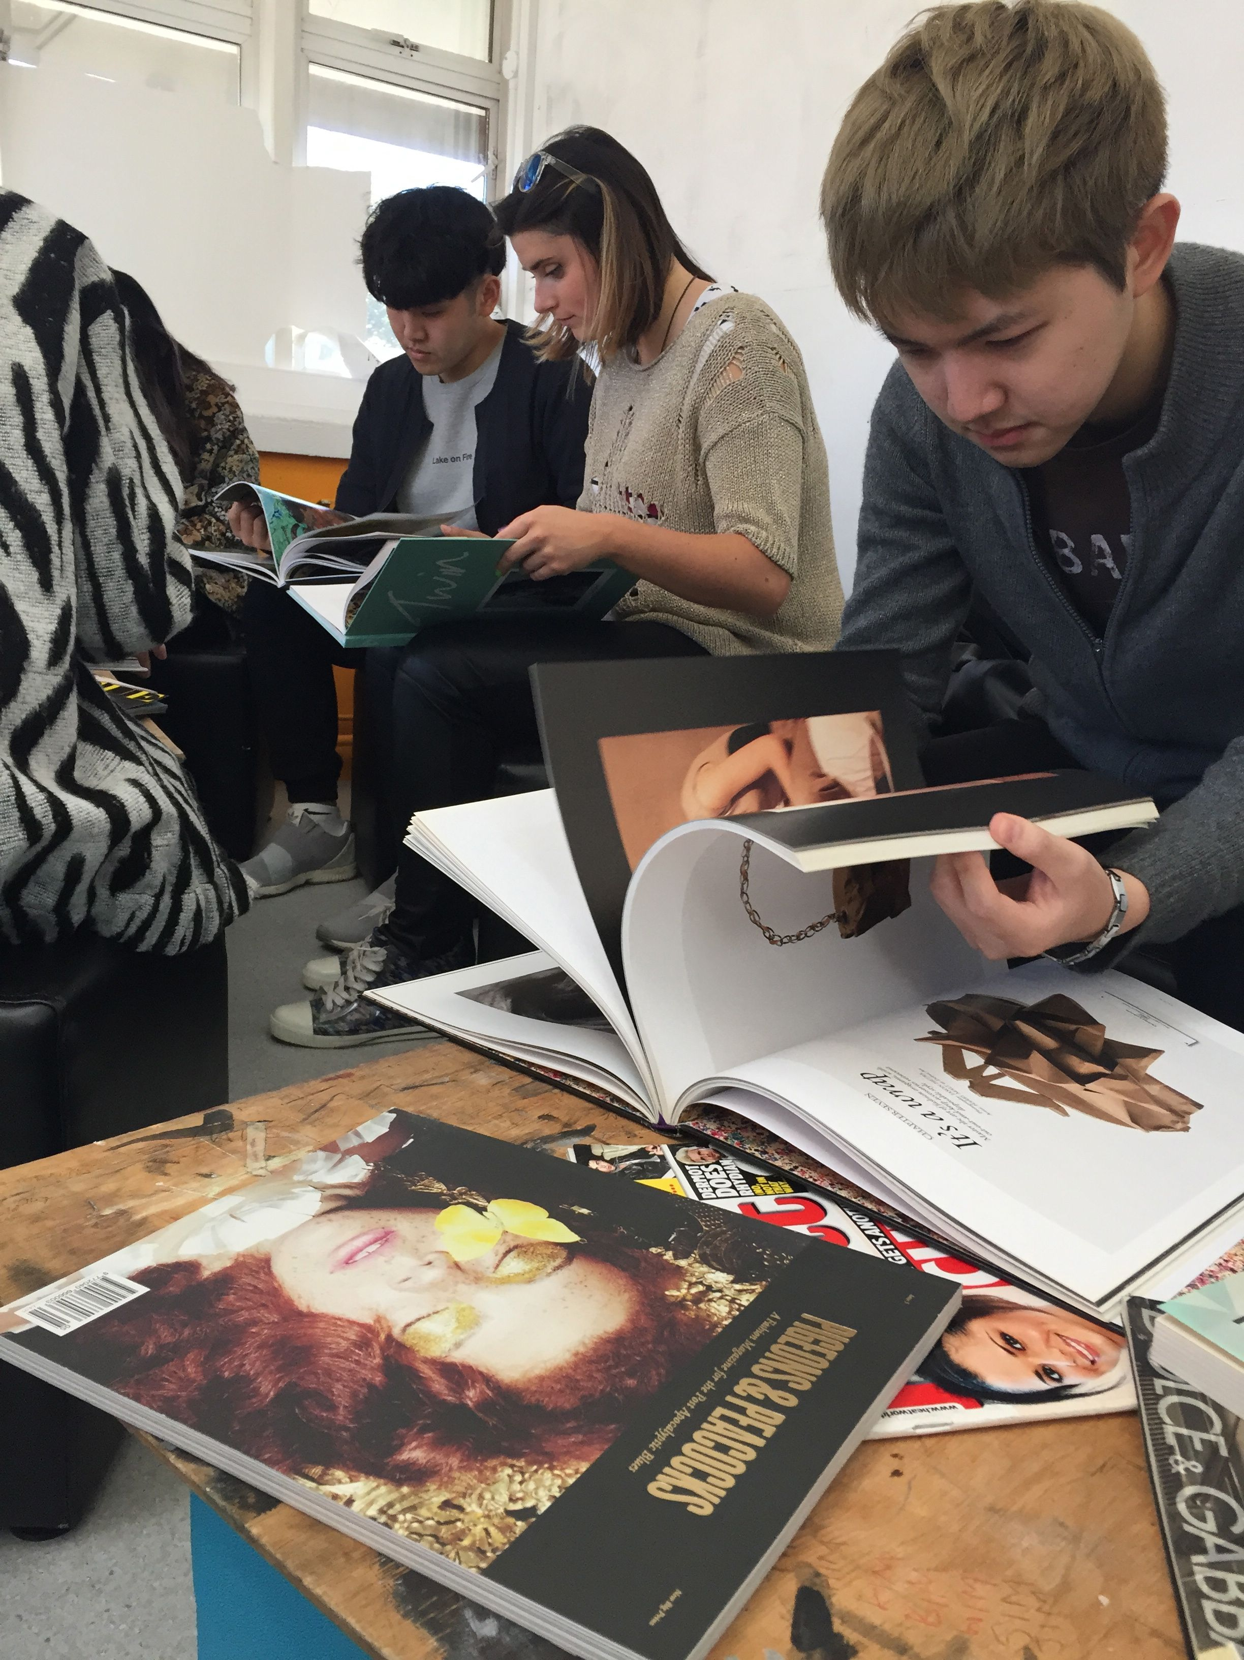
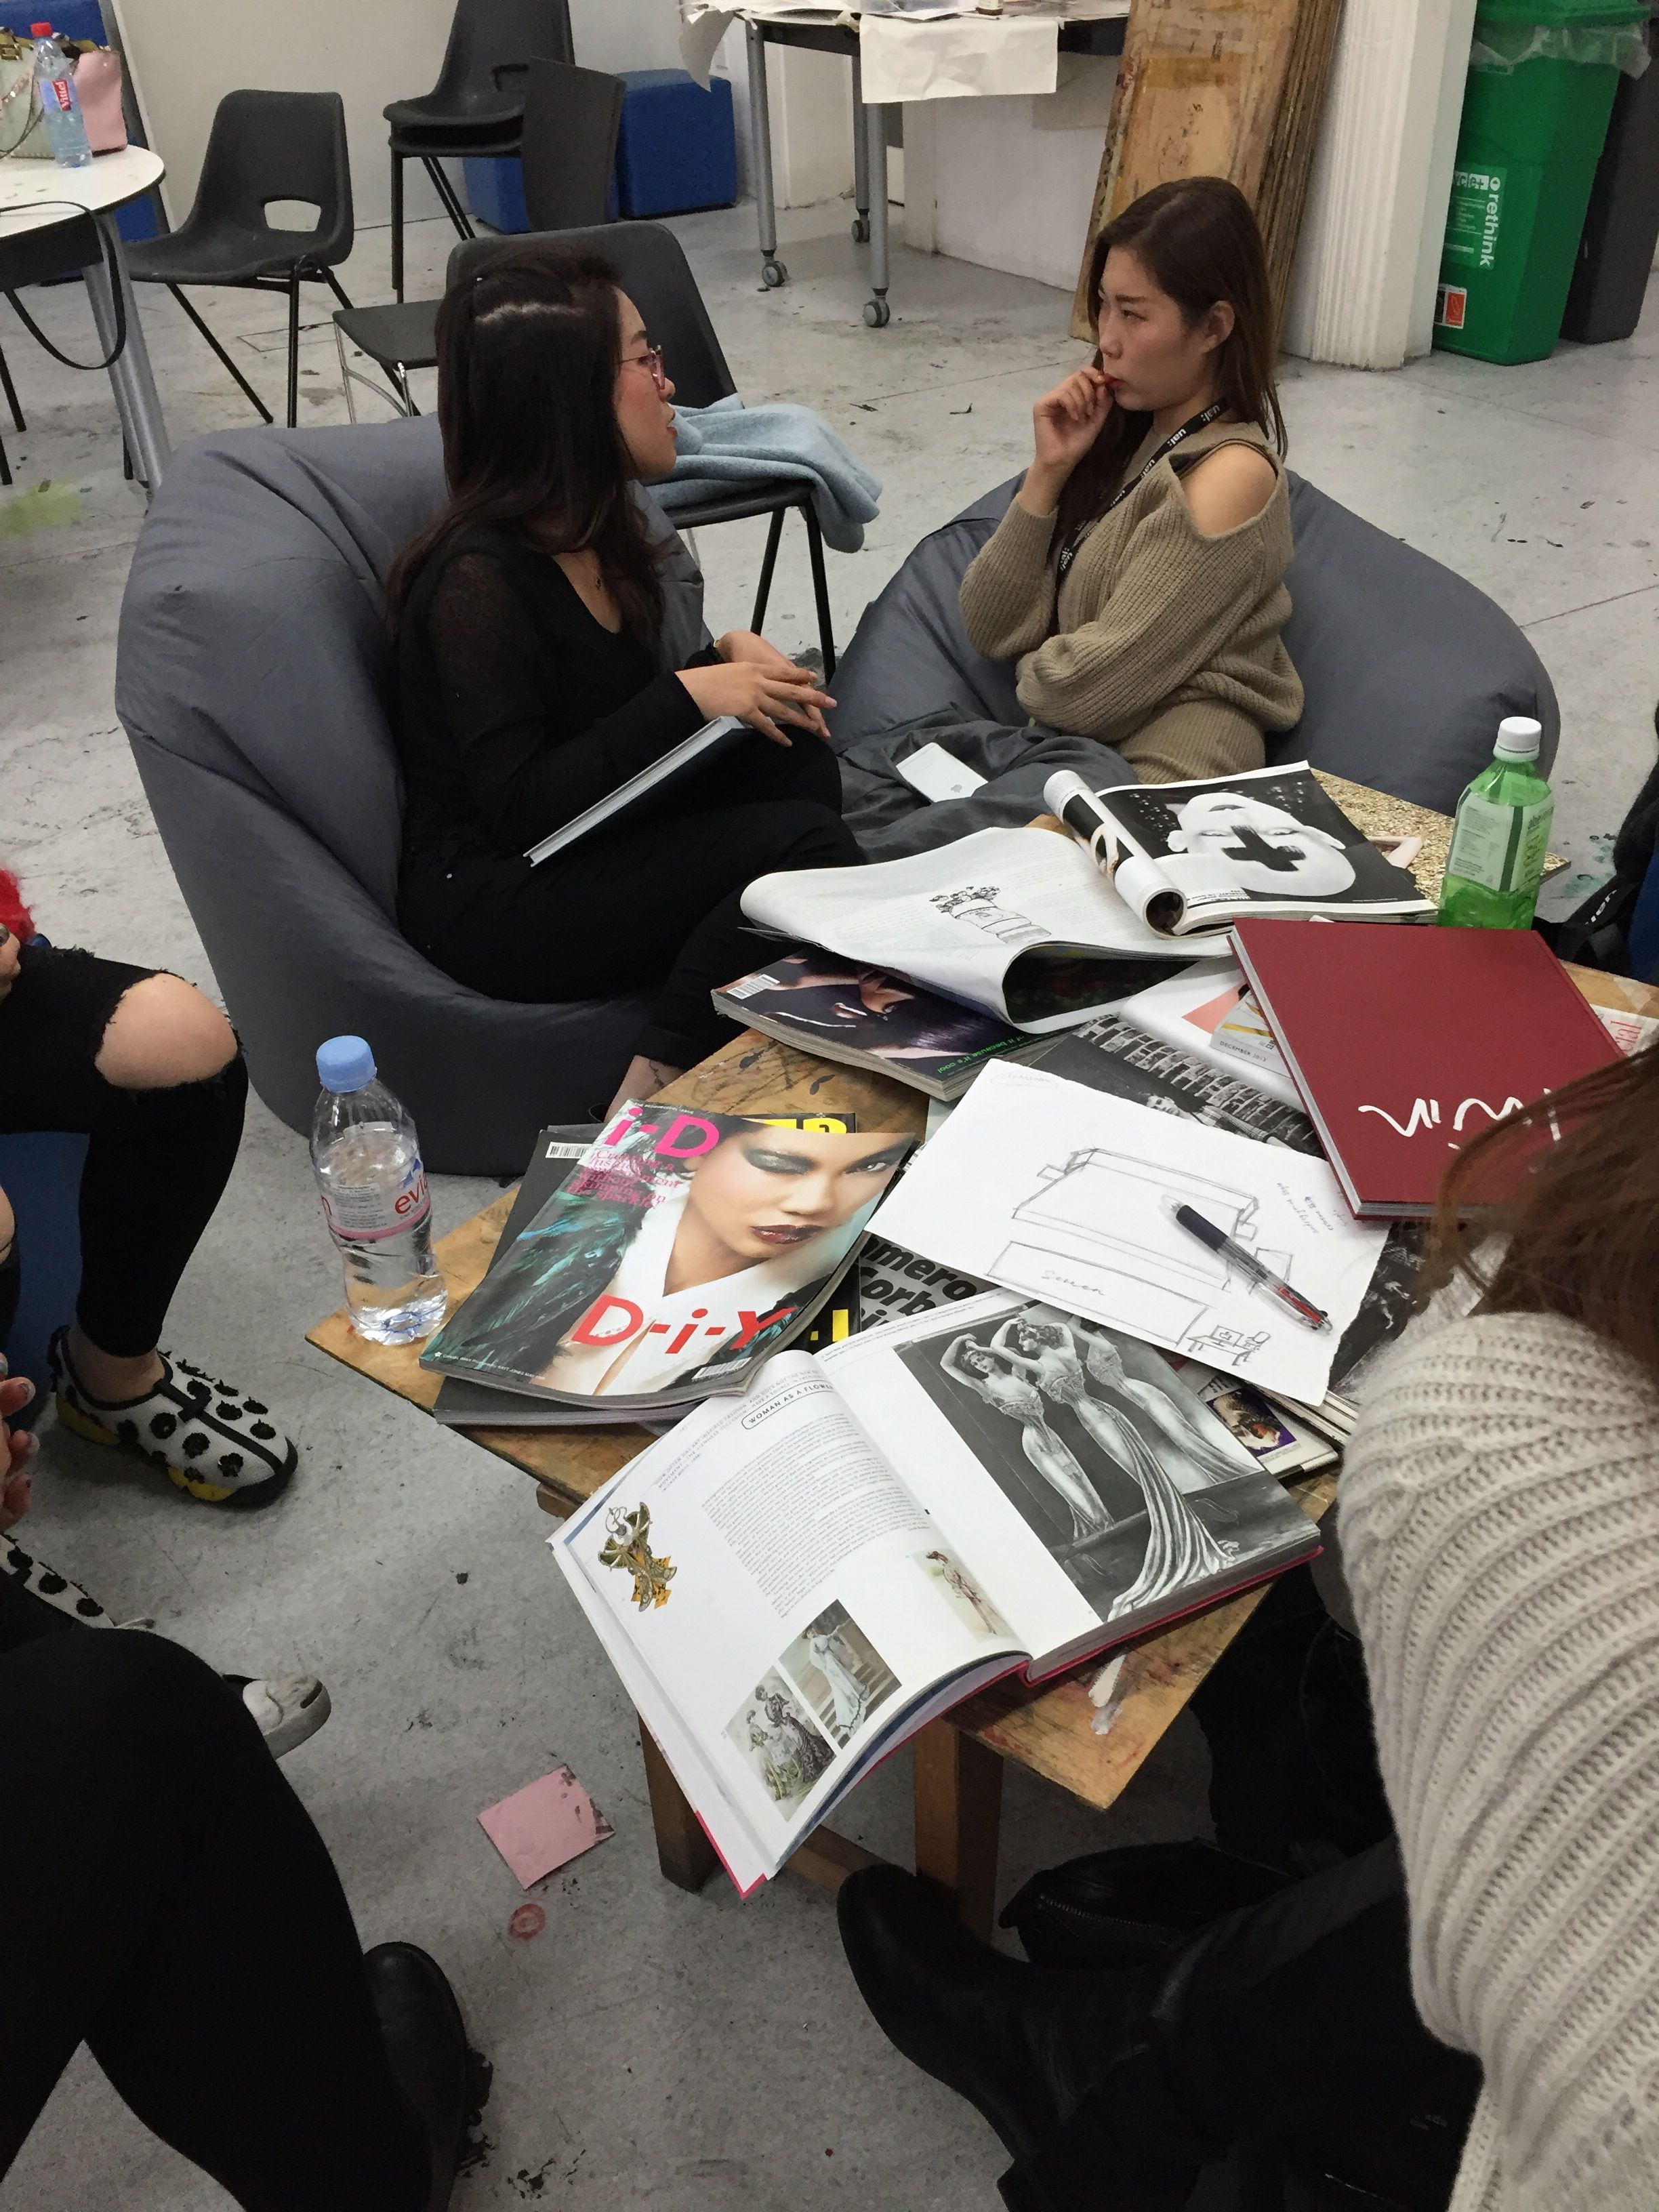
Image of students in space that they have created transferred to different rooms
A101 – the drawing room
A102 – the tutorial room
A204 - the design studio
A206 – the media seminar room

Slide 17
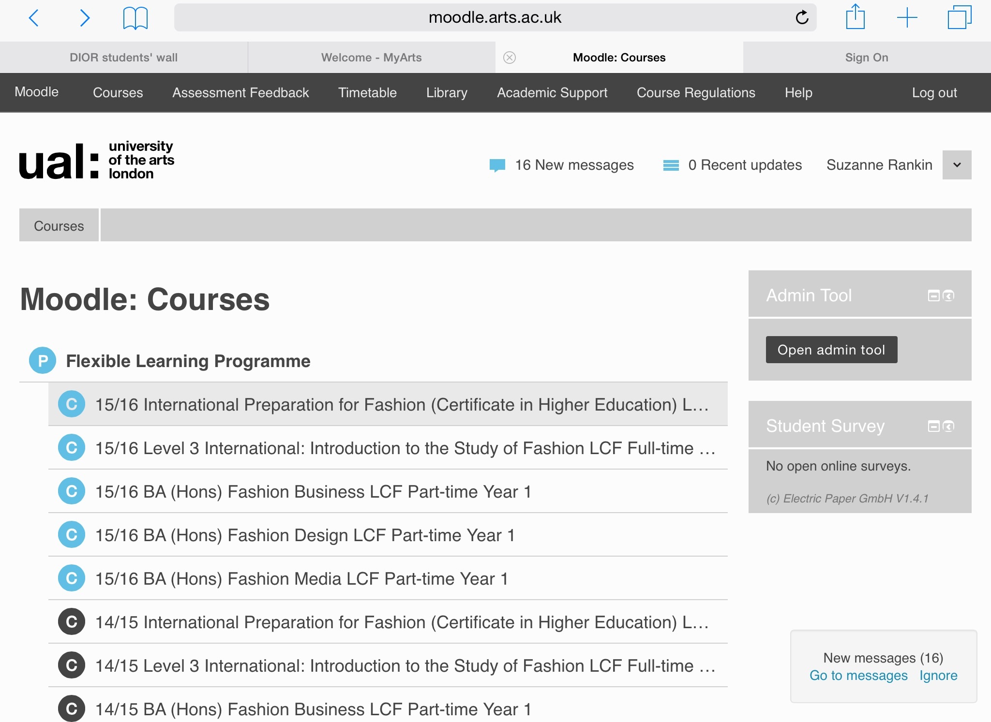
The virtual space
Smooth virtual space
Striated virtual space

Slide 18
The issues raised
Ownership empowerment – confidence building
Personalisation improving the student experience and developing a greater understanding of learning space and their place within it
Cultural capital ‘International students arrive equipped with a valuable skillset.’ (Ryan, 2005)
Sense of belonging ‘Fostering an an inclusive culture, valuing and embracing diversity’
(HEA, 2014)

Slide 19
So, whose space is it anyway?
A shared space that can be personalised and nomadic
A combination of smooth and striated spaces or smooth spaces created within striated spaces.
‘Never believe that a smooth space will suffice to save us’ (Deleuze and Guattari, 1988, p 500)

Slide 20
Bibliography
Bayne, S (2004) Smoothness and Striation in Digital Learning Spaces. E-Learning, Volume 1, Number 2
Caroll, J., and Ryan, J. (2005) (eds) Teaching international students: improving learning for all. London; New York: Routledge.
Deleuze,G and Guattari, F (1988) A Thousand Plateaus London; New York: Continuum
Higher Education Authority (2014) Internationalising Higher Education Framework; HEA
Savin-Baden, M (2008) Learning Spaces: Creating Opportunities for Knowledge Creation in Academic Life London; Society for Research into Higher Eductaion and Open university Press

