Slide 1
“Challenging thinking, creativity and problem solving.”
Art and design technicians’ conception of their role in Higher Education
Clare Sams

Slide 2
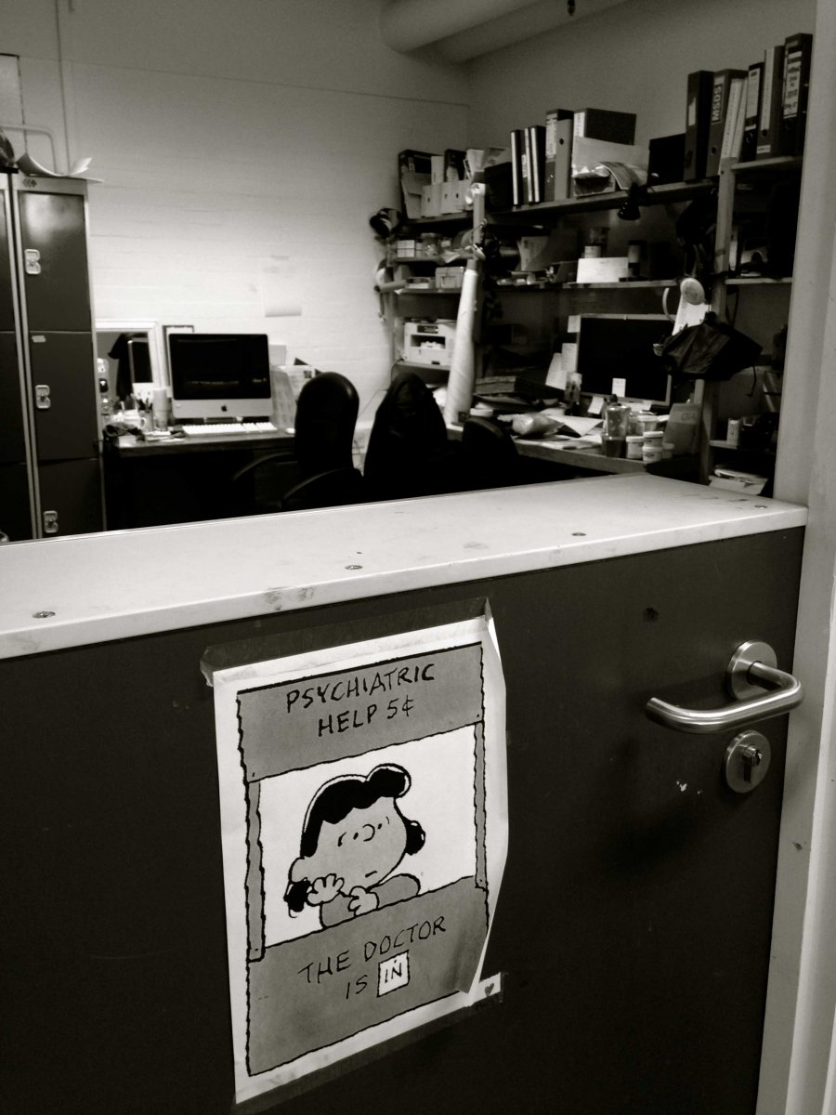

Slide 3
“The technician office is the place where students seek for support, information and someone to talk to. It’s always open (except lunch time). There is always someone to talk to.”

Slide 4
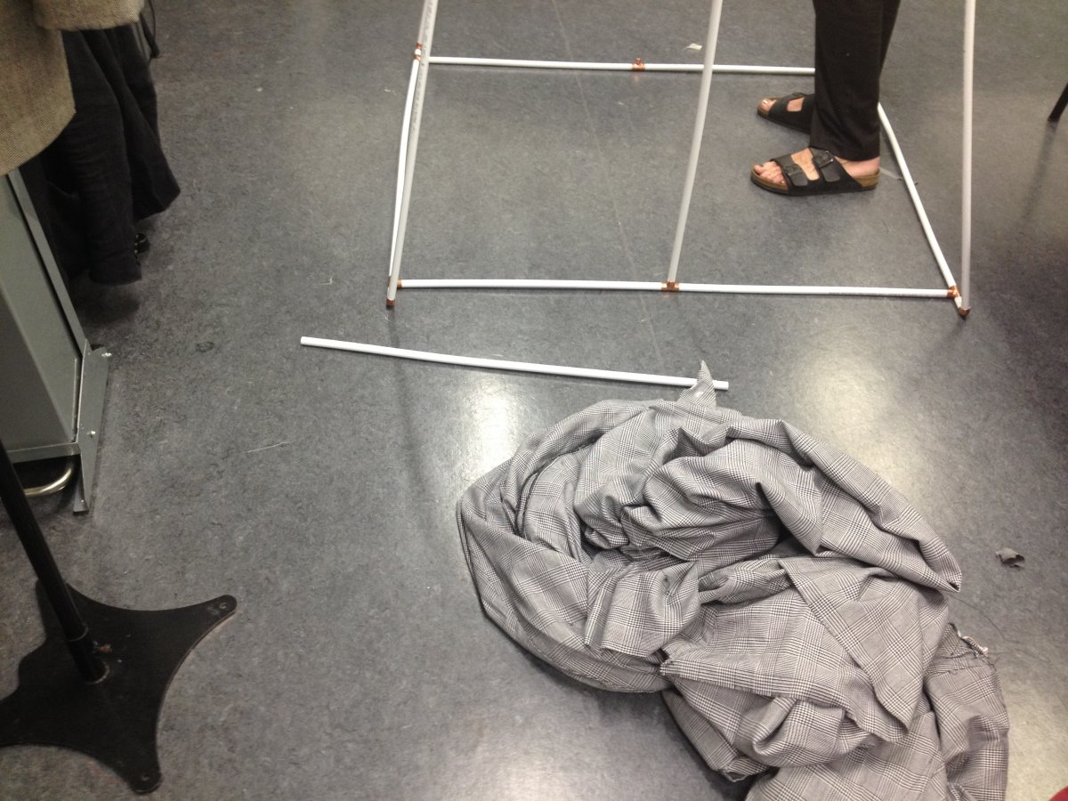

Slide 5
‘The role demands a complexity of thinking and facilitating a huge range of students enquiries, using my expertise and knowledge applied to a wide variety of different students’ approaches and individual ways of learning.
It shows one approach of working one to one with individual students; taking a student through the process of an idea to realisation. Challenging thinking, creativity and problem solving for a diverse range of outcomes.’

Slide 6
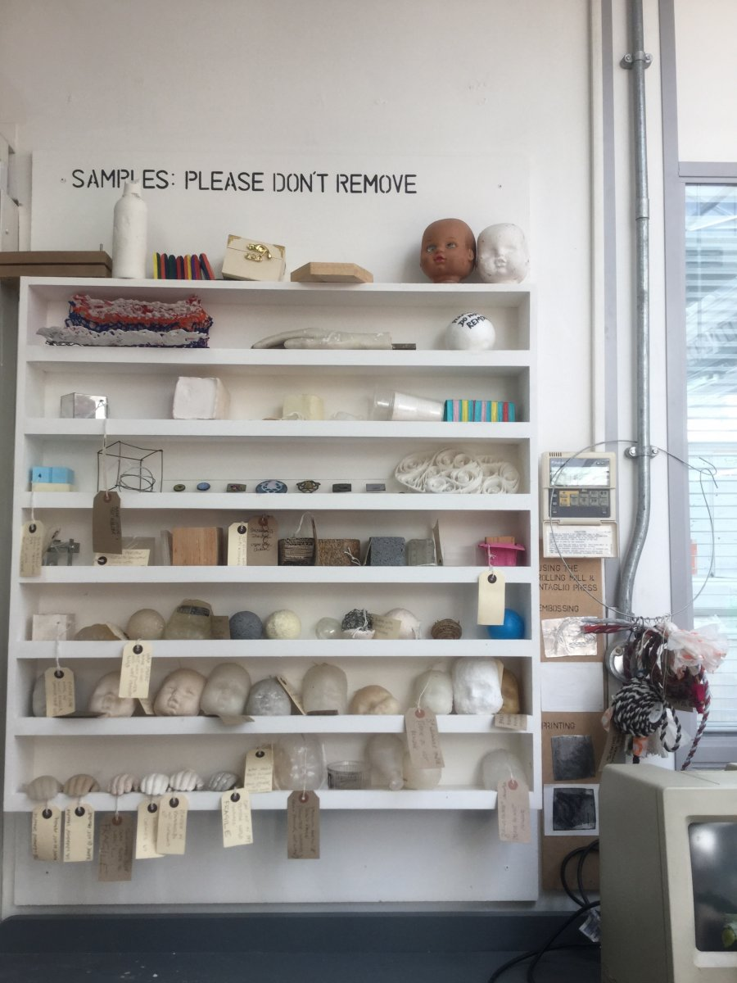

Slide 7
‘The images are of the learning resources technicians make as samples of materials and processes available to them at the 3D workshop.
My colleagues were responsible for setting up process arts, so this is a smaller offline version of that. It promotes discussion with students and helps hugely with their understanding of materials and processes as they are free to handle them.’

Slide 8
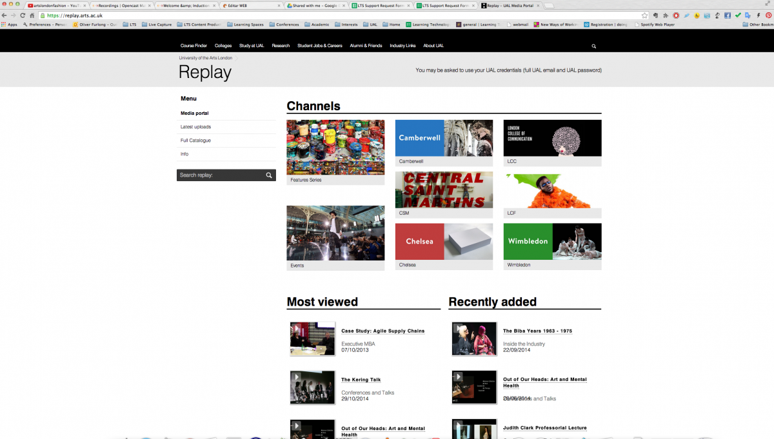

Slide 9
‘The replay portal was designed for live capture content or videos captured by camera operated systems. It could be said I work in getting content captured and also making media rich online content available. Increasingly we are involved in live mixing and video streaming content, and this is an area we are keen to research and explore for the UAL, as another way of reaching prospective students, and other international audiences.’

Slide 10
What is the art and design technicians’ conception of their role in Higher education?
There are three distinct conceptions of the technicians’ role in higher education:
Academic support technicians
These technicians may prepare materials or equipment for the use of academic lecturers in their teaching practice, and may also be a point of contact for students in the absence of academic staff.
Learning environment technicians
These technicians use their knowledge of artefacts to help to create learning environments for lectures. They work at events, in lecture theatres, and virtual learning environments to create the right conditions for student learning.
Also under this banner are technical managers who support technical staff in terms of management and staff development, so helping to create the technical learning environments.
Technical lecturers
These technicians use their knowledge directly to teach students how to use artefacts in their own creative practice. They perform what Smith (2004) called 'quasi-teaching' work as a regular part of their role in learning and teaching.
The unifying elements of the way technicians’ viewed their role was one of supporting student learning, and utilizing expert knowledge in equipment within a discipline. Expertise in the materials, tools and processes of these disciplines were the key to express the role in learning and teaching, whether in workshops, virtual learning environments, or other supporting roles in higher education.

Slide 11
Blythman,M, Parker,B. and Tiffin,S. (2008) Forget the academic staff! The contribution to creative learning in practice of technical staff and equipment. Enhancing the curricula CLTAD conference, New York, April 2008
Braddock,D.(1995) What is a technician? Occupational quarterly. Spring 1995 Volume 39:1, 38
Hunt,N. and Melrose,S. (2005) Techne, Technology, Technician ;The creative practices of the mastercraftsperson. Performance research: A journal of the performing Arts 10:4, 70 – 82, DOI:10:1080/:3528165.2005.1000871452
Macfarlane,B. (2011) The Morphing of Academic Practice: Unbundling and the rise of the Para-academic. Higher Education Quarterly 65:1, 59-73
Polanyi,M. (1966) The Tacit Dimension, Routledge, London
Shreeve,A. (2009) “I’d rather be seen as a practitioner, come in to teach my subject.”: Identity work in part-time Art and Design tutors. IJADE 28.2 (2009) NSEAD/Blackwell
Smith, D.N., Adams, J., Mount, D., Reeve, N., Wilkinson, D. (2004) Highly skilled technicians in higher education: A report to HEFCE by Evidence Ltd
Vere, K. (2013). In Defence of the University Technician. [ONLINE] Available at: http://www.theguardian.com/higher-education-network/blog/2013/aug/02/university-technician-teaching-research-development.
Wang, C. (1999) Photovoice: A participatory action research strategy applied to women’s health. Journal of Women’s Health. Volume 8:issue 2: Pages 185-192 pub March 1999

