Slide 1
The Digital Student Experience at UAL
bit.ly/digistudentUAL
CC BY-NC-ND attributable to Charlotte Webb, Maria Georgaki and David White, Teaching and Learning Exchange, UAL, 2015.

Slide 2
Why?
Seek student perspective
Provide Moodle data
Build on staff report

Slide 3
Qualitative
Approach
Quantitative
Focus groups
10 students
Survey
433 students

Slide 4
Anxiety
A general state often
amplified by missing info or info in the wrong place

Slide 5
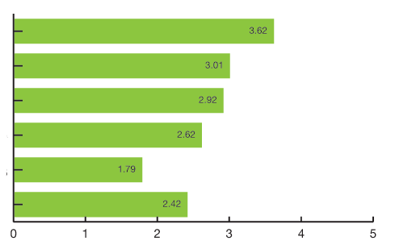
Findings
Which of these things make
you anxious about your course?
I miss communications about important deadlines
I don’t know where to find course info online
I am overwhelmed by information
I don’t feel ready to share my work online
I don’t feel comfortable using Facebook groups
I cannot contact my tutor online
Not at all
anxious
Extremely
anxious
Notes:
This question aimed to understand what is high on students’ minds as they undertake their courses.
The answer options covered both practical issues such as accessing information, as well as other issues raised in the focus groups e.g. information overload, & self-consciousness about sharing work.
Students most anxious about missing important deadlines or assignments information
This correlates with Q1 - accessing practical course information is very important to students.

Slide 6
Findings
I can easily find course information
on Moodle
Strongly disagree
Strongly agree
Strongly agree – 9%
Agree – 37%
Neither agree no disagree - 22%
Disagree – 24%
Strongly disagree – 8%
Notes:
It is clear that many students struggle to find information on Moodle, with less than half saying they can easily find course information. Moodle upgrade has improved overall navigation and look and feel

Slide 7
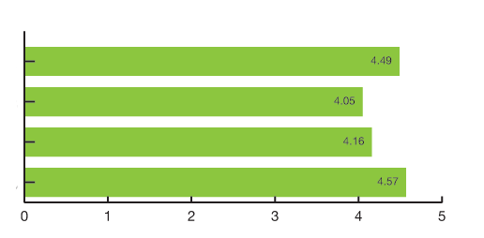
Findings
How important is the following
information to you?
Where & when my lectures/classes are being delivered
Who is delivering the lecture/class
Related lecture/class materials
Tutor feedback & assessment results
Not at all
important
Extremely
important
Notes:
This question attempted to gain more insight into problems students expressed during the focus groups around accessing information.
Each piece of information in the answer options is something that courses could make available via Moodle.
The high rating averages indicate that students place a high degree of importance on obtaining all the listed pieces of information.

Slide 8
So…
Course teams have to be smart about communicating info
Digital is not inherently organised
Notes:
Now that Moodle architecture is working wellthe focus needs to be on course teams coordinating sites really well – agreeing location of information and their editorial/ownership processes.
Making sure there is content in each section

Slide 9
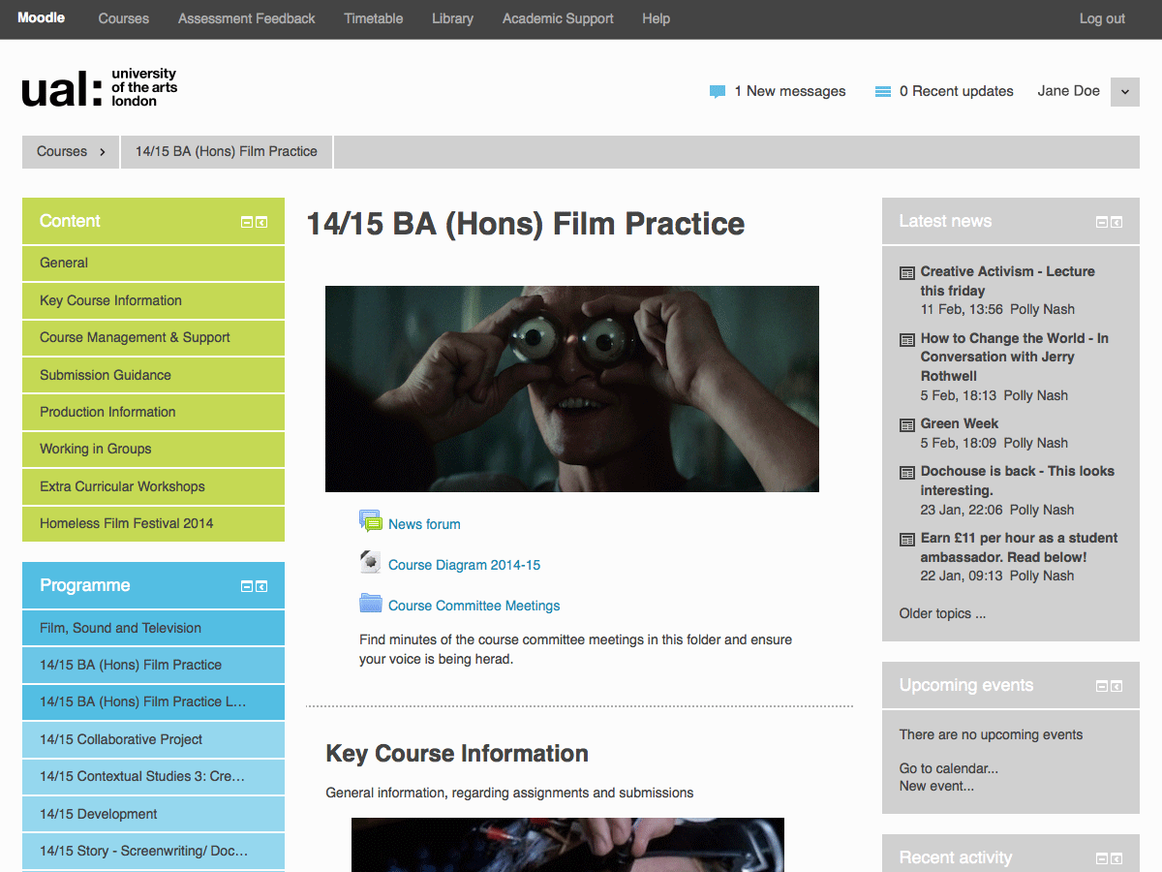
Notes:
Now that Moodle architecture is working wellthe focus needs to be on course teams coordinating sites really well – agreeing location of information and their editorial/ownership processes.
Making sure there is content in each section

Slide 10
Organised
Moodle:
Editorial approach
Use of the course hierarchy
Consistency
Keeping an eye on email/comms
Notes:
Now that Moodle architecture is working wellthe focus needs to be on course teams coordinating sites really well – agreeing location of information and their editorial/ownership processes.
Making sure there is content in each section

Slide 11
Anxiety is also
worsened when students panic about technical skills
(contrary to the ‘digital natives’ idea)
Notes:
We can’t use the digital natives

Slide 12
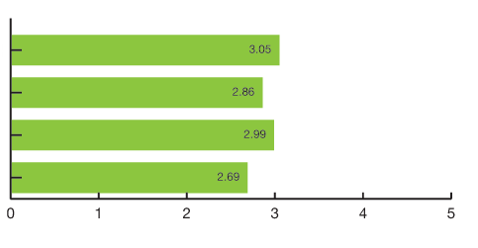
Findings
The following stops me completing my
coursework to the best of my ability
I do not have the technical skills I need
I haven’t been inducted in the equipment/software I need
I can’t access the equipment/software I need
I don’t have enough access to working spaces with wifi
Strongly disagree
Strongly agree
Notes:
This question aimed to gain insight into probs students expressed during the focus groups around skills, equipment and software induction
We can’t use the ‘digital natives’ assumption to deliver tech to students without rationalising its use.
The even spread of rating averages suggests that all these factors can contribute to students being hampered in completing their coursework.
The fact that students struggle with different things perhaps represents the general challenges of HE, where support has to cover a broad range of student needs.
As such, this kind of response should be understood as relevant in a much wider context than Moodle.
The answers correlate generally with the 2013 E-Learning at UAL report finding that ‘a lack of confidence in the use of tools can be exacerbated by the experience of unreliability in the infrastructure on which these platforms sit (e.g. networks and hardware).

Slide 13
So…
Course teams: rationalise why as well as showing how
Notes:
Something we need to work on – think about how to frame the digital – how we frame the why as well as how

Slide 14
A student perspective
UAL tools only part of the picture
The boundaries are fuzzy

Slide 15
Complex negotiations
Technology
Practices
Social spaces

Slide 16
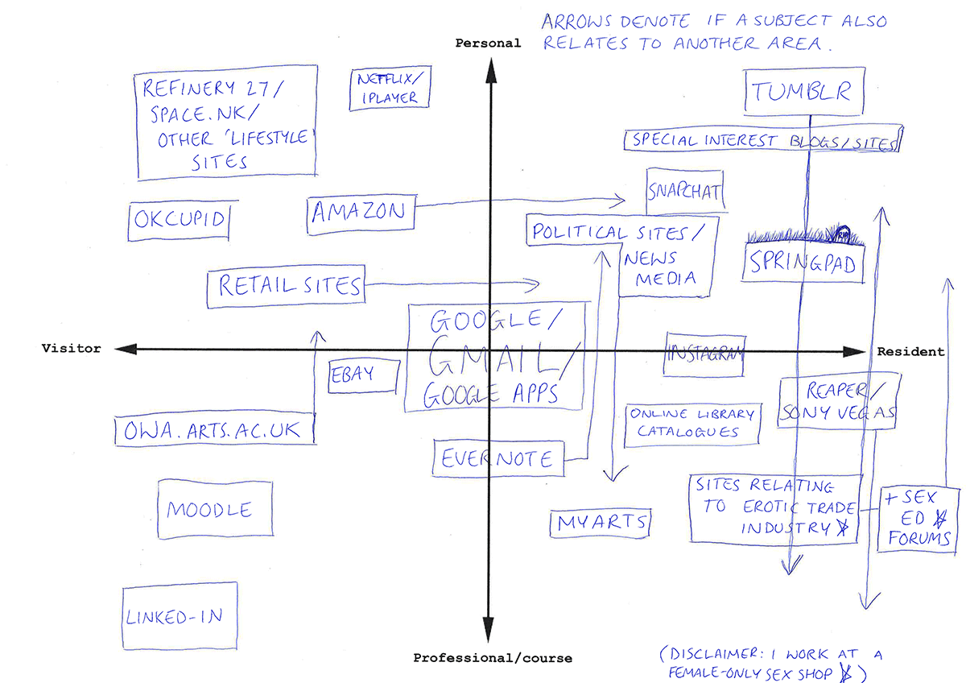

Slide 17
Our responses
4 new TEL coordinators
Moodle upgrade – better architecture and navigation
Notes:
TEL coordinators are 0.6 FTE
Support course teams in pedagogical use of TEL platforms & act as point of contact for general support issues
Close connection w Exchange – CoP

Slide 18
Activity
Digital Capabilities

Slide 19
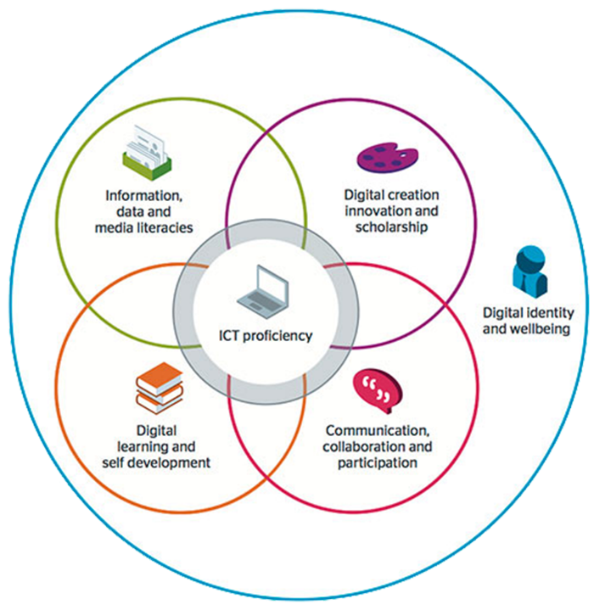
Jisc
Digital Capabilities

Slide 20
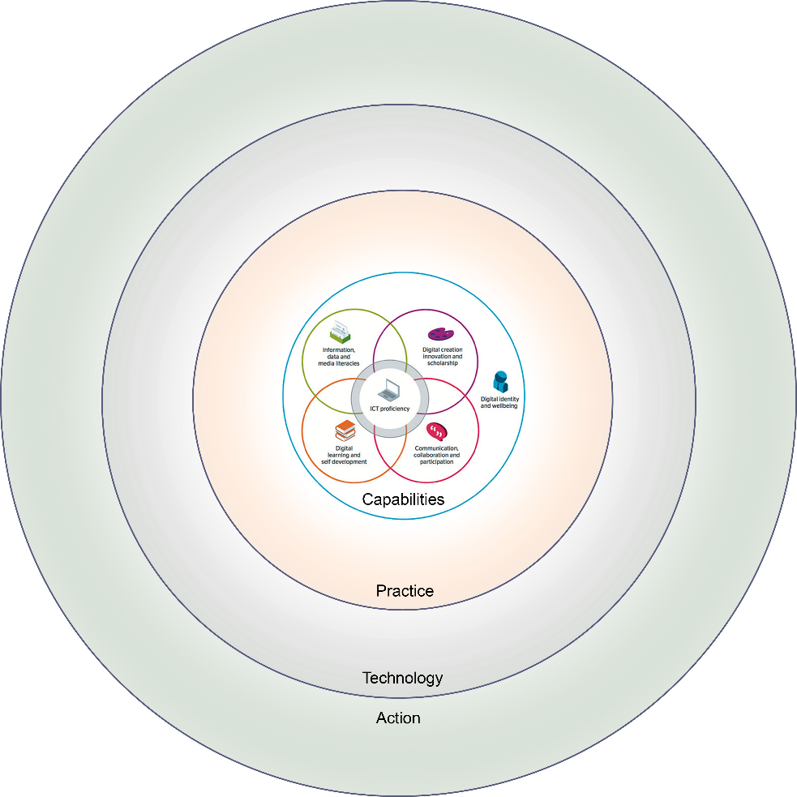
Digital Capabilities

Slide 21
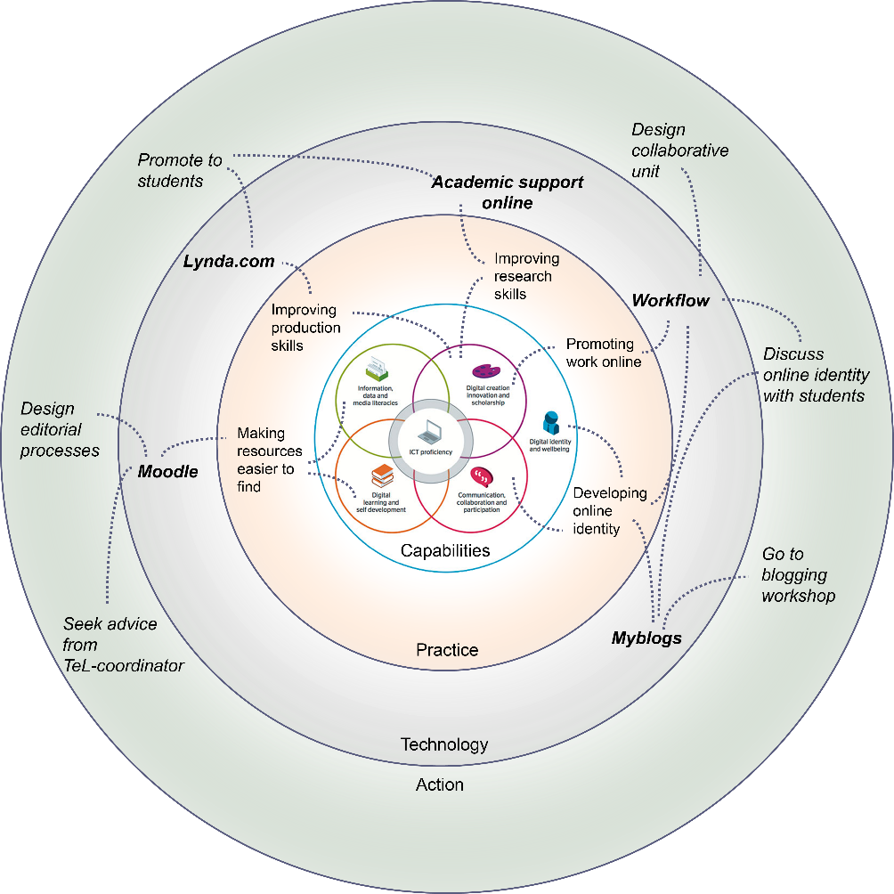
Digital Capabilities

